Slide 1
Estimating p for X~Bernoulli(p)
Estimating p for X~Bernoulli(p)
Markov’s Inequality
Chebyshev’s Inequality
The Chebyshev Bound for Number of Heads
The Chebyshev Bound for Estimating the Fairness of a Coin
Weak Law of Large Numbers
Bounds Beyond CS70
Lecture 22, CS70 Fall 2025

Slide 2
Motivating Problem of the Day
Suppose we wanted to know in advance how many people will vote for Donald Trump in the 2024 election.
One approach: Ask random people.
As long as we ask enough of the right people, we’ll get an accurate result.
But how many people do we need to ask?

Slide 3
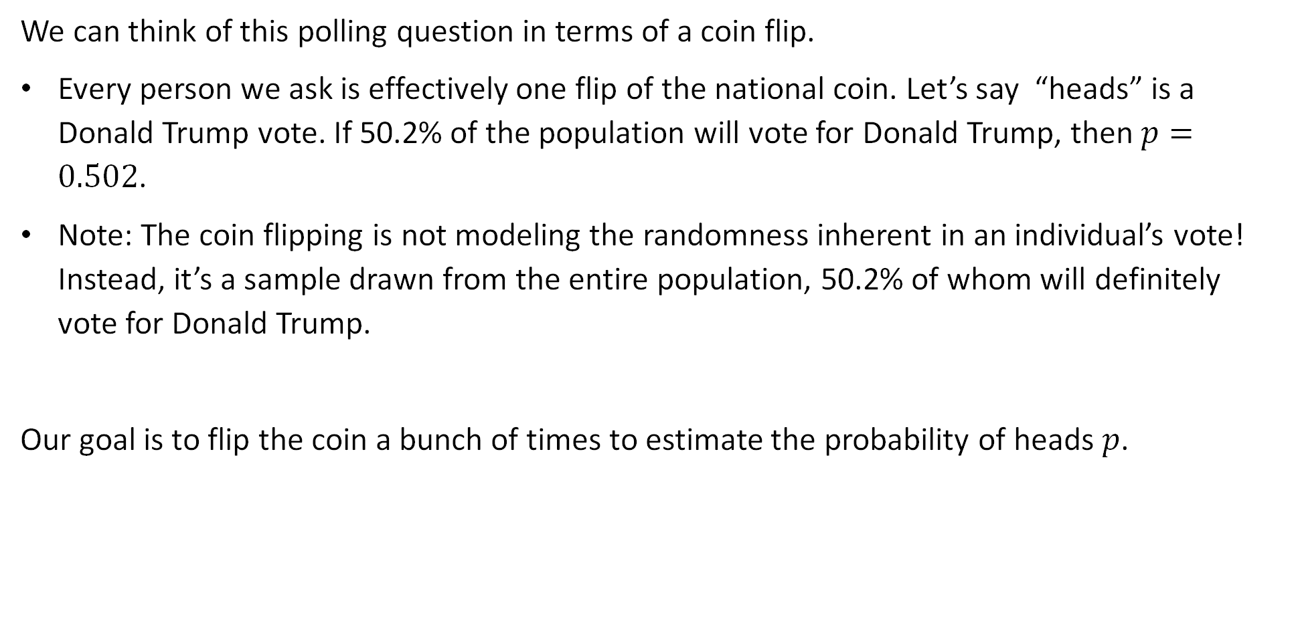
Motivating Problem of the Day: Coin Version
We can think of this polling question in terms of a coin flip.
Every person we ask is effectively one flip of the national coin. Let’s say “heads” is a Donald Trump vote. If 50.2% of the population will vote for Donald Trump, then $p=0.502$.
Note: The coin flipping is not modeling the randomness inherent in an individual’s vote! Instead, it’s a sample drawn from the entire population, 50.2% of whom will definitely vote for Donald Trump.
Our goal is to flip the coin a bunch of times to estimate the probability of heads $p$.

Slide 4

Experiment
Suppose we flip the coin 10,000 times and we get heads 4800 times and tails 5200 times? Let $p$ be the true chance of heads. Let $\hat{p}$ be our estimate.
Based on our experiment, what should we use as $\hat{p}$?

Slide 5

Experiment
Suppose we flip the coin 10,000 times and we get heads 4800 times and tails 5200 times? Let $p$ be the true chance of heads. Let $\hat{p}$ be our estimate.
Based on our experiment, what should we use as $\hat{p}$? $\hat{p}=0.48$
(as you also saw on Homework 11, Problem 4a)

Slide 6
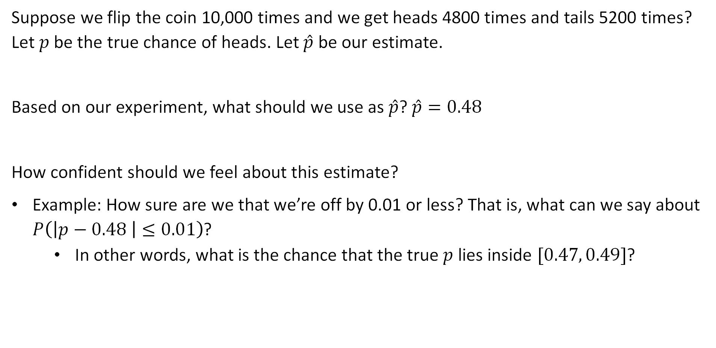
Experiment
Suppose we flip the coin 10,000 times and we get heads 4800 times and tails 5200 times? Let $p$ be the true chance of heads. Let $\hat{p}$ be our estimate.
Based on our experiment, what should we use as $\hat{p}$? $\hat{p}=0.48$
How confident should we feel about this estimate?
Example: How sure are we that we’re off by 0.01 or less? That is, what can we say about $P\left(\left|p−0.48 \right|≤0.01\right)$?
  In other words, what is the chance that the true $p$ lies inside $[0.47, 0.49]$?

Slide 7
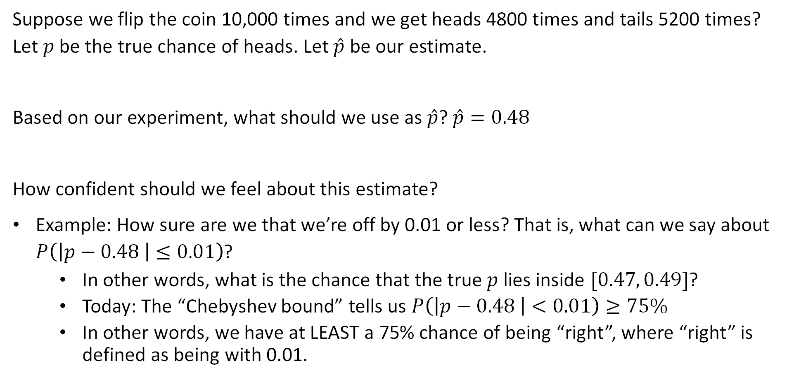
Experiment
Suppose we flip the coin 10,000 times and we get heads 4800 times and tails 5200 times? Let $p$ be the true chance of heads. Let $\hat{p}$ be our estimate.
Based on our experiment, what should we use as $\hat{p}$? $\hat{p}=0.48$
How confident should we feel about this estimate?
Example: How sure are we that we’re off by 0.01 or less? That is, what can we say about $P\left(\left|p−0.48 \right|≤0.01\right)$?
  In other words, what is the chance that the true $p$ lies inside $[0.47, 0.49]$?
  Today: The “Chebyshev bound” tells us $P\left(\left|p−0.48 \right|<0.01\right)≥75\%$
  In other words, we have at LEAST a 75% chance of being “right”, where “right” is defined as being with 0.01.

Slide 8
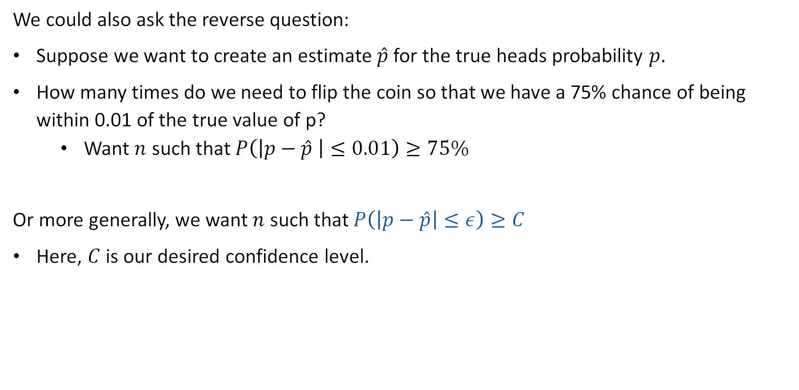
Other Framing
We could also ask the reverse question:
Suppose we want to create an estimate $\hat{p}$ for the true heads probability $p$.
How many times do we need to flip the coin so that we have a 75% chance of being within 0.01 of the true value of p?
  Want $n$ such that $P\left(\left|p−\hat{p} \right|≤0.01\right)≥75\%$
Or more generally, we want $n$ such that $P\left(\left|p−\hat{p}\right|≤ε\right)≥C$
Here, $C$ is our desired confidence level.

Slide 9
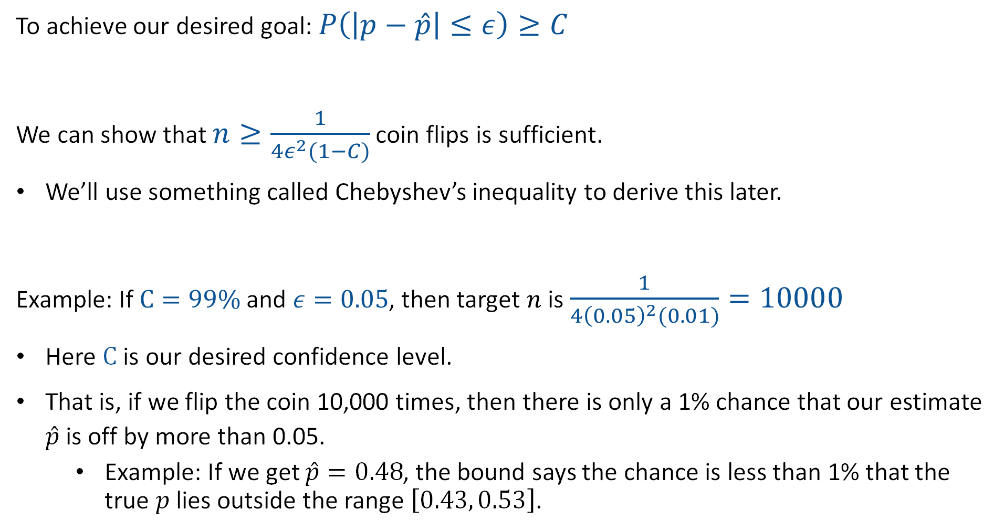
Today’s Answer (Spoiler)
To achieve our desired goal: $P\left(\left|p−\hat{p}\right|≤ε\right)≥C$
We can show that $n≥\frac{1}{4ε^{2}(1−C)}$ coin flips is sufficient.
We’ll use something called Chebyshev’s inequality to derive this later.
Example: If $C=99\%$ and $ε=0.05$, then target $n$ is $\frac{1}{4{\left(0.05\right)}^{2}(0.01)}=10000$
Here $C$ is our desired confidence level.
That is, if we flip the coin 10,000 times, then there is only a 1% chance that our estimate $\hat{p}$ is off by more than 0.05.
  Example: If we get $\hat{p}=0.48$, the bound says the chance is less than 1% that the true $p$ lies outside the range $\left[0.43, 0.53\right]$.

Slide 10
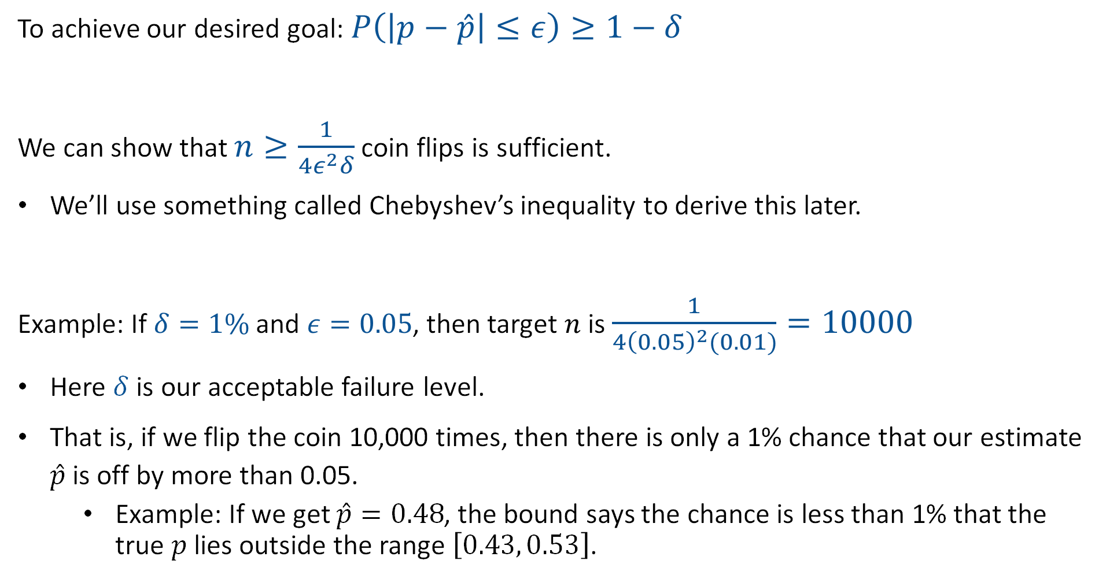
Today’s Answer (Alternate Form)
To achieve our desired goal: $P\left(\left|p−\hat{p}\right|≤ε\right)≥1−δ$
We can show that $n≥\frac{1}{4ε^{2}δ}$ coin flips is sufficient.
We’ll use something called Chebyshev’s inequality to derive this later.
Example: If $δ=1\%$ and $ε=0.05$, then target $n$ is $\frac{1}{4{\left(0.05\right)}^{2}(0.01)}=10000$
Here $δ$ is our acceptable failure level.
That is, if we flip the coin 10,000 times, then there is only a 1% chance that our estimate $\hat{p}$ is off by more than 0.05.
  Example: If we get $\hat{p}=0.48$, the bound says the chance is less than 1% that the true $p$ lies outside the range $\left[0.43, 0.53\right]$.

Slide 11
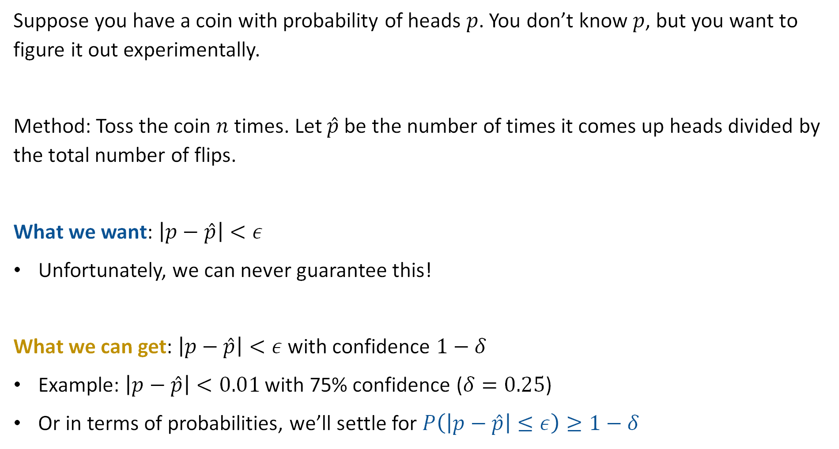
Experimental Procedure for Determining $p$
Suppose you have a coin with probability of heads $p$. You don’t know $p$, but you want to figure it out experimentally.
Method: Toss the coin $n$ times. Let $\hat{p}$ be the number of times it comes up heads divided by the total number of flips.
What we want: $\left|p−\hat{p}\right|<ε$
Unfortunately, we can never guarantee this!
What we can get: $\left|p−\hat{p}\right|<ε$ with confidence $1−δ$
Example: $\left|p−\hat{p}\right|<0.01$ with 75% confidence ($δ=0.25$)
Or in terms of probabilities, we’ll settle for $P\left(\left|p−\hat{p}\right|≤ε\right)≥1−δ$

Slide 12
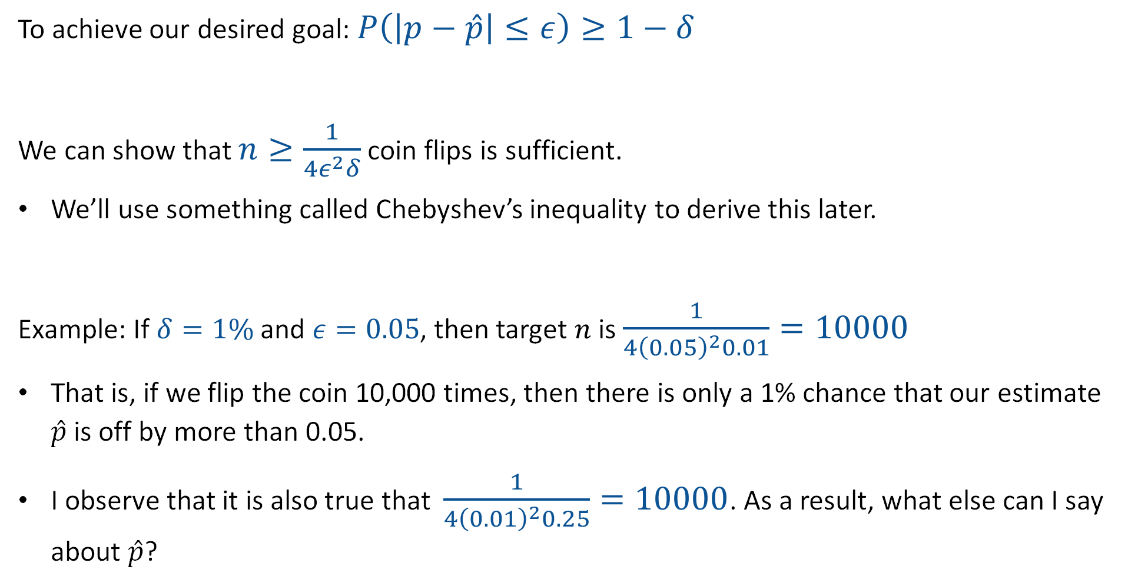
Today’s Answer (Spoiler)
To achieve our desired goal: $P\left(\left|p−\hat{p}\right|≤ε\right)≥1−δ$
We can show that $n≥\frac{1}{4ε^{2}δ}$ coin flips is sufficient.
We’ll use something called Chebyshev’s inequality to derive this later.
Example: If $δ=1\%$ and $ε=0.05$, then target $n$ is $\frac{1}{4{\left(0.05\right)}^{2}0.01}=10000$
That is, if we flip the coin 10,000 times, then there is only a 1% chance that our estimate $\hat{p}$ is off by more than 0.05.
I observe that it is also true that $\frac{1}{4{\left(0.01\right)}^{2}0.25}=10000$. As a result, what else can I say about $\hat{p}$?

Slide 13
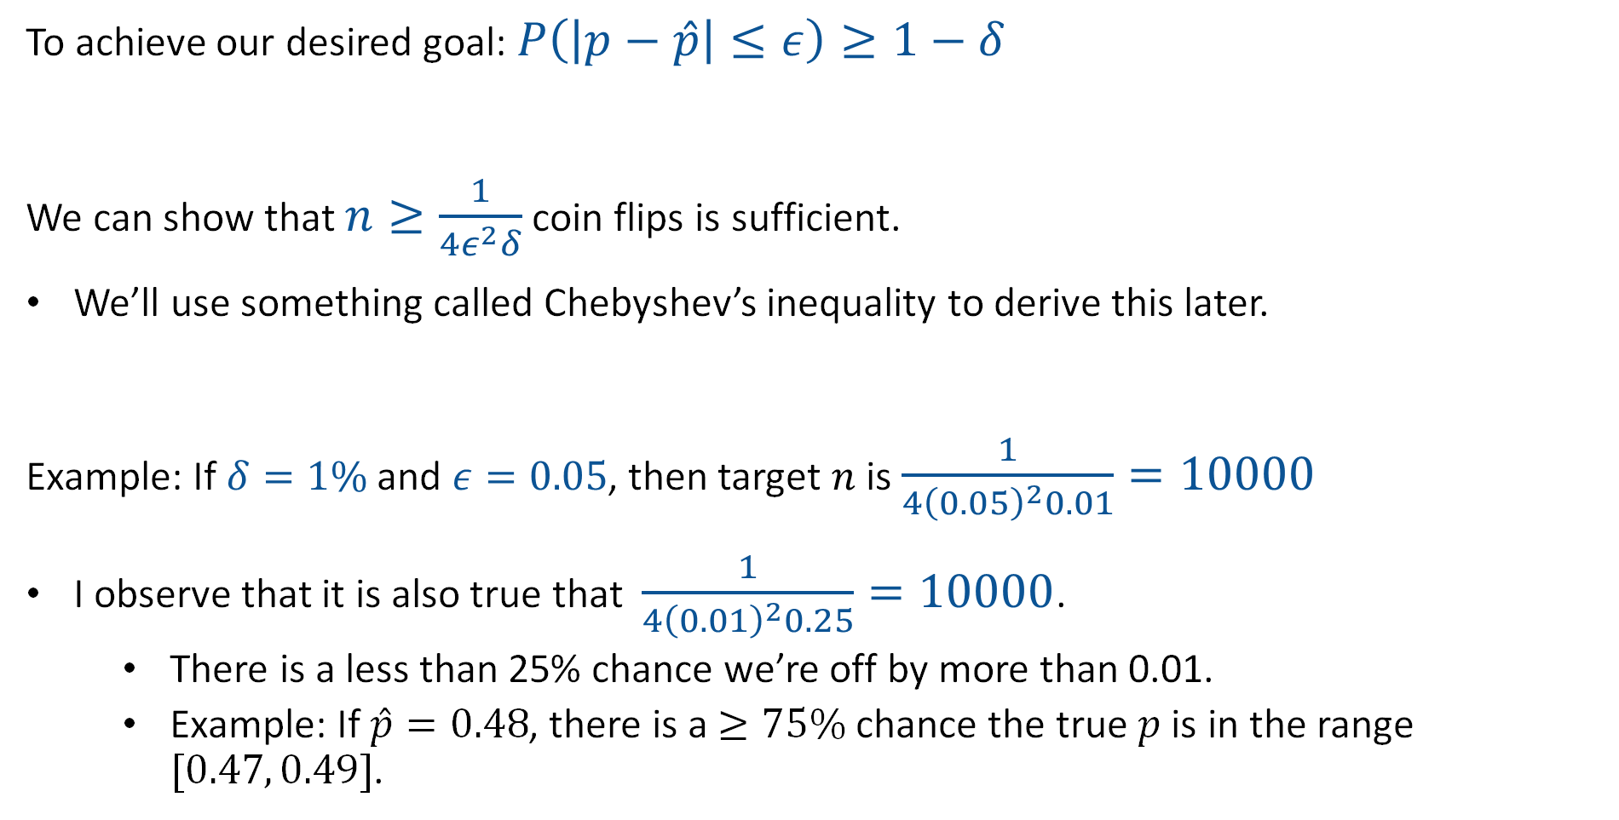
Today’s Answer (Spoiler)
To achieve our desired goal: $P\left(\left|p−\hat{p}\right|≤ε\right)≥1−δ$
We can show that $n≥\frac{1}{4ε^{2}δ}$ coin flips is sufficient.
We’ll use something called Chebyshev’s inequality to derive this later.
Example: If $δ=1\%$ and $ε=0.05$, then target $n$ is $\frac{1}{4{\left(0.05\right)}^{2}0.01}=10000$
I observe that it is also true that $\frac{1}{4{\left(0.01\right)}^{2}0.25}=10000$.
  There is a less than 25% chance we’re off by more than 0.01.
  Example: If $\hat{p}=0.48$, there is a $≥75\%$ chance the true $p$ is in the range $[0.47, 0.49]$.

Slide 14
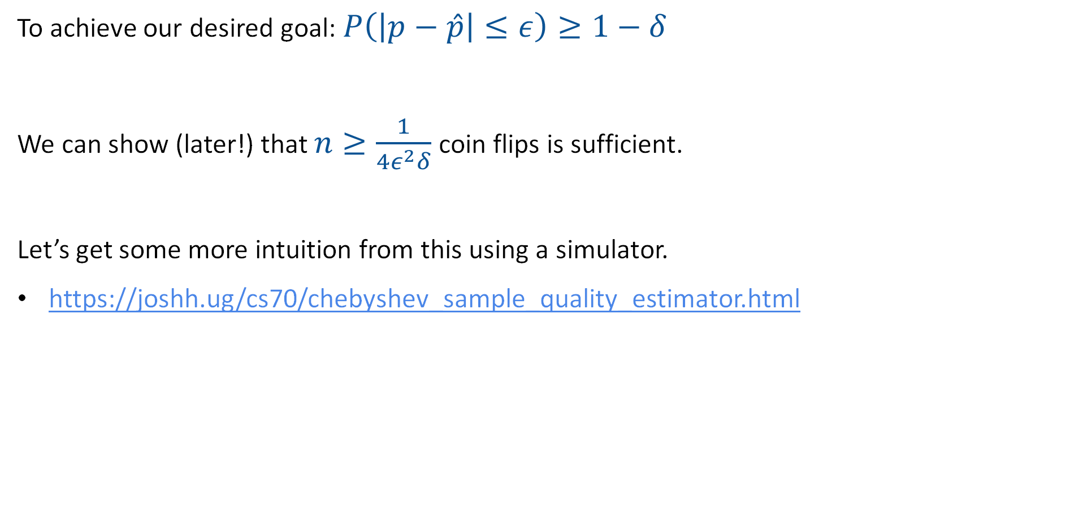
Understanding this Bound
To achieve our desired goal: $P\left(\left|p−\hat{p}\right|≤ε\right)≥1−δ$
We can show (later!) that $n≥\frac{1}{4ε^{2}δ}$ coin flips is sufficient.
Let’s get some more intuition from this using a simulator.
https://joshh.ug/cs70/chebyshev_sample_quality_estimator.html

Slide 15
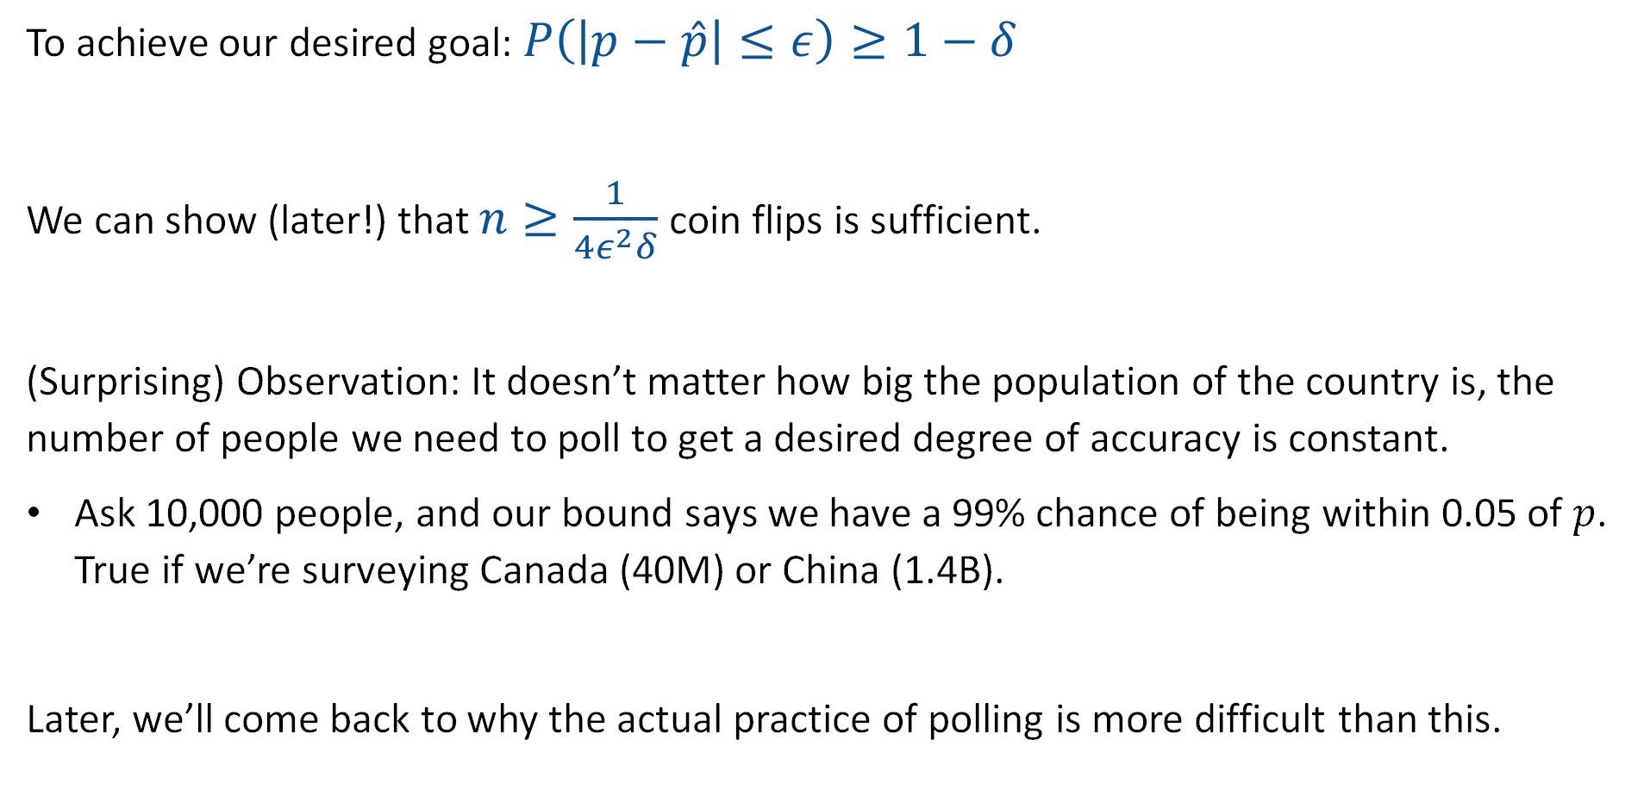
In Terms of Election Polling
To achieve our desired goal: $P\left(\left|p−\hat{p}\right|≤ε\right)≥1−δ$
We can show (later!) that $n≥\frac{1}{4ε^{2}δ}$ coin flips is sufficient.
(Surprising) Observation: It doesn’t matter how big the population of the country is, the number of people we need to poll to get a desired degree of accuracy is constant.
Ask 10,000 people, and our bound says we have a 99% chance of being within 0.05 of $p$. True if we’re surveying Canada (40M) or China (1.4B).
Later, we’ll come back to why the actual practice of polling is more difficult than this.

Slide 16
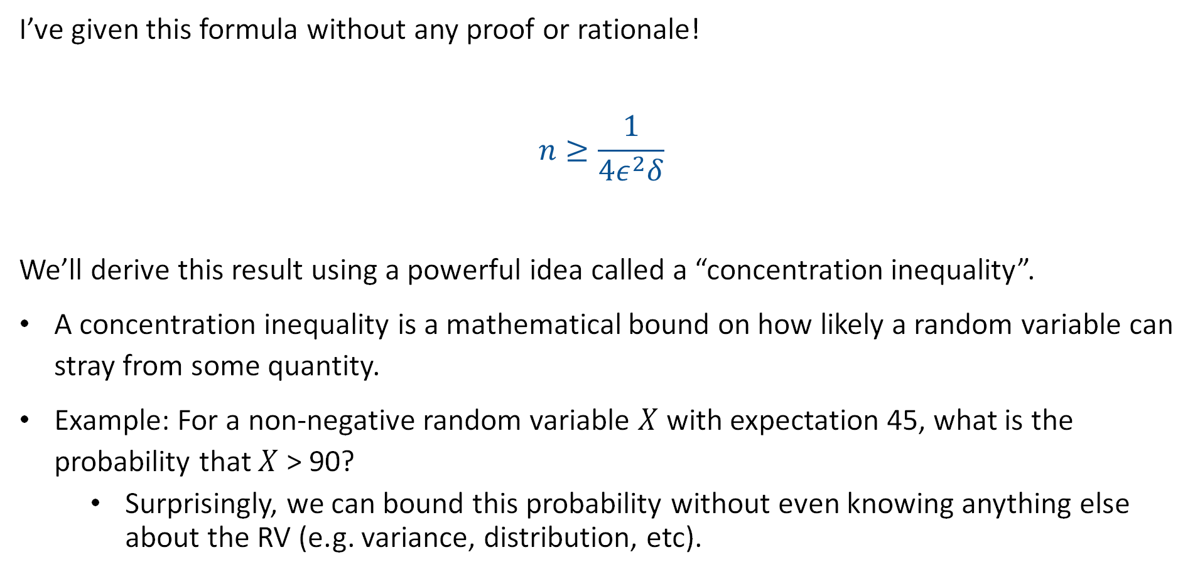
Deriving this Expression and Concentration Inequalities
I’ve given this formula without any proof or rationale!
$$n≥\frac{1}{4ε^{2}δ}$$
We’ll derive this result using a powerful idea called a “concentration inequality”.
A concentration inequality is a mathematical bound on how likely a random variable can stray from some quantity.
Example: For a non-negative random variable $X$ with expectation 45, what is the probability that $X$ > 90?
  Surprisingly, we can bound this probability without even knowing anything else about the RV (e.g. variance, distribution, etc).

Slide 17
Markov’s Inequality
Estimating p for X~Bernoulli(p)
Markov’s Inequality
Chebyshev’s Inequality
The Chebyshev Bound for Number of Heads
The Chebyshev Bound for Estimating the Fairness of a Coin
Weak Law of Large Numbers
Bounds Beyond CS70
Lecture 22, CS70 Fall 2025

Slide 18

Thought Experiment 1
Imagine that 100 students take a midterm with average score $μ=45$.
Can all 100 students score greater than $μ=45$ on the midterm?

Slide 19
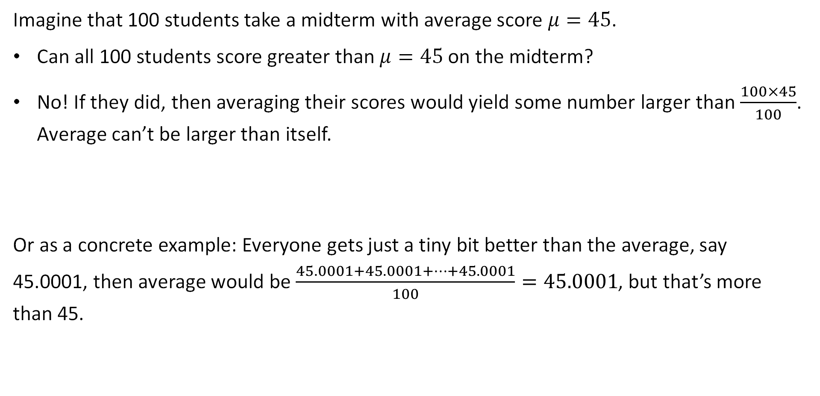
Thought Experiment 1
Imagine that 100 students take a midterm with average score $μ=45$.
Can all 100 students score greater than $μ=45$ on the midterm?
No! If they did, then averaging their scores would yield some number larger than $\frac{100×45}{100}$. Average can’t be larger than itself.
Or as a concrete example: Everyone gets just a tiny bit better than the average, say 45.0001, then average would be $\frac{45.0001+45.0001+…+45.0001}{100}=45.0001$, but that’s more than 45.

Slide 20


Thought Experiment 2
Imagine that 100 students take a midterm with average score $μ=45$.
Can 50 students earn a score greater than or equal to $2μ=90$ on the midterm?
joshh.ug/B

Slide 21
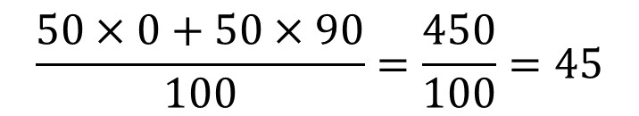
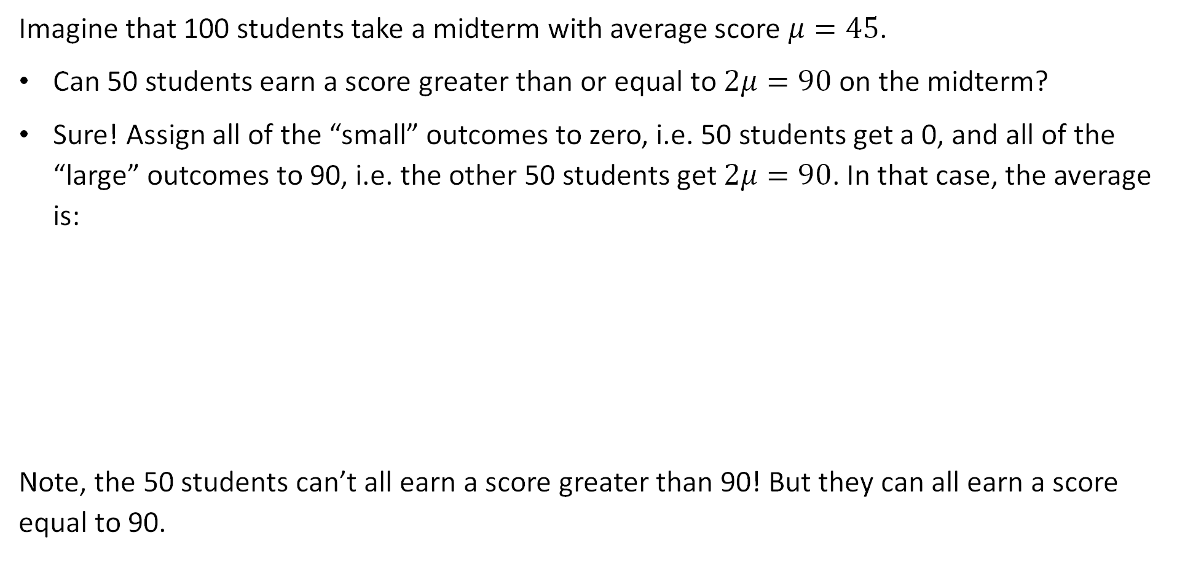
Thought Experiment 2
Imagine that 100 students take a midterm with average score $μ=45$.
Can 50 students earn a score greater than or equal to $2μ=90$ on the midterm?
Sure! Assign all of the “small” outcomes to zero, i.e. 50 students get a 0, and all of the “large” outcomes to 90, i.e. the other 50 students get $2μ=90$. In that case, the average is:
Note, the 50 students can’t all earn a score greater than 90! But they can all earn a score equal to 90.
$$\frac{50×0+50×90}{100}=\frac{450}{100}=45$$

Slide 22


Thought Experiment 3
Imagine that we have n people whose average bank account balance is $μ=\$5,000$. What is the maximum possible fraction who have $\$15,000$ in their account?
joshh.ug/C

Slide 23

Thought Experiment 3
Imagine that we have n people whose average bank account balance is $μ=\$5,000$. What is the maximum possible fraction who have $\$15,000$ in their account?
The maximum possible fraction is 1/3rd:
  2/3rds of people have zero dollars.
  1/3rd have $15,000.
$15000
$0

Slide 24

Thought Experiment 4
Consider a nonnegative random variable with $𝔼\left[X\right]=5000$. Let $p$ be the probability that $P\left(X≥15000\right)$.
What is the largest possible value for $p$?

Slide 25







Thought Experiment 4
Consider a nonnegative random variable with $𝔼\left[X\right]=5000$. Let $p$ be the probability that $P\left(X≥15000\right)$.
What is the largest possible value for $p$?
We know that $p≤1/3$.
In the most extreme case, $X\left(ω\right)=15000$ for 1/3rd of the sample space and $X\left(ω\right)=0$ for the other 2/3rds of the sample space.
$$X\left(ω_{2}\right)=0$$
$$X\left(ω_{1}\right)=15000$$
$$X\left(ω_{4}\right)=0$$
$$X\left(ω_{3}\right)=15000$$
$$X\left(ω_{5}\right)=0$$
$$X\left(ω_{6}\right)=0$$

Slide 26
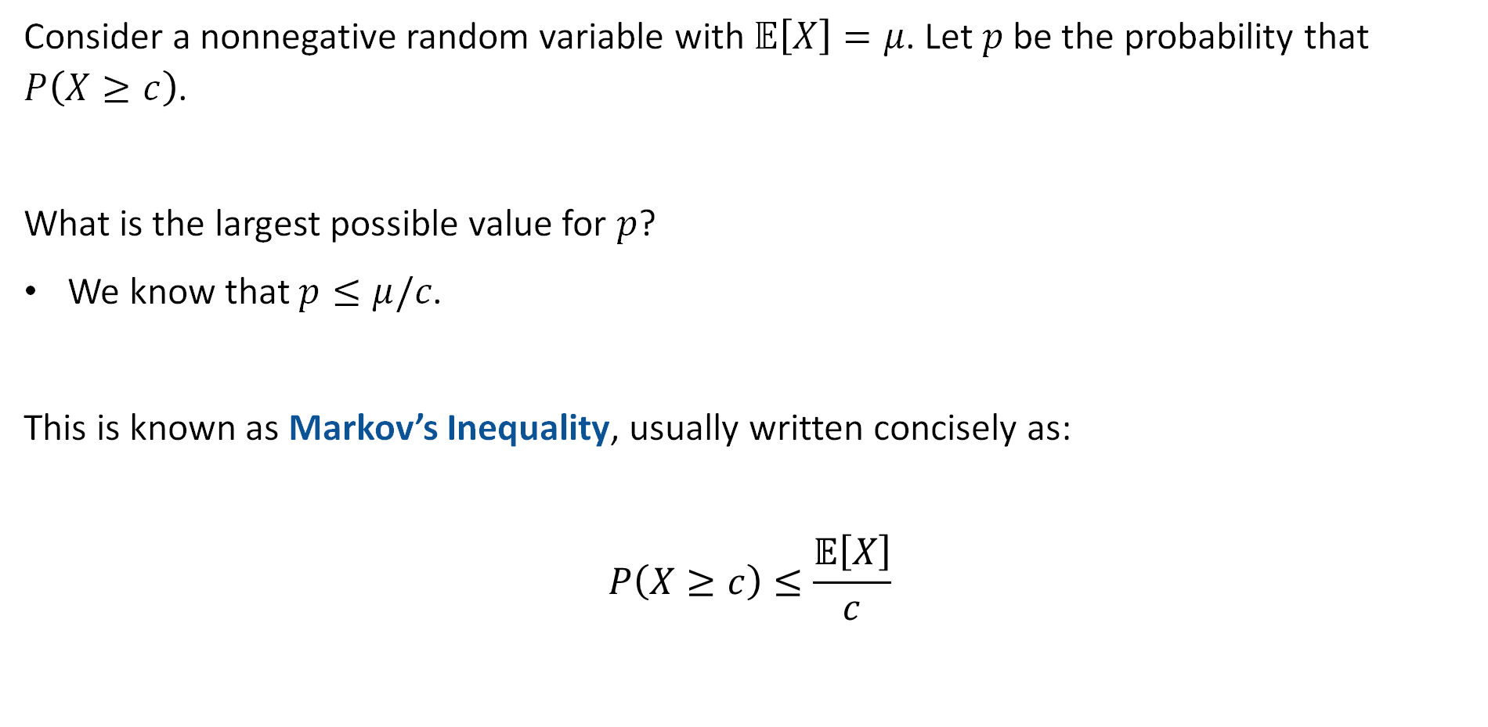
Thought Experiment 4
Consider a nonnegative random variable with $𝔼\left[X\right]=μ$. Let $p$ be the probability that $P\left(X≥c\right)$.
What is the largest possible value for $p$?
We know that $p≤μ/c$.
This is known as Markov’s Inequality, usually written concisely as:
$$P\left(X≥c\right)≤\frac{𝔼\left[X\right]}{c}$$

Slide 27





Markov’s Inequality
Markov’s Inequality: For a nonnegative random variable $X$ (i.e. $X\left(ω\right)≥0$ for all $ω∈Ω$) with finite mean, we have that for any positive constant c:
$$P\left(X≥c\right)≤\frac{𝔼\left[X\right]}{c}$$
Proof from the notes (exact same idea that we used) using mega-verbose form of expectation:
$$𝔼\left[X\right]=\sum_{ω∈Ω}{X\left(ω\right)×P\left(ω\right)}$$
$$≥\sum_{ω:X\left(ω\right)≥c}{X(ω)×P\left(ω\right)}$$
Assigning all “small” outcomes to zero.
$$≥\sum_{ω:X\left(ω\right)≥c}{c×P\left(ω\right)}$$
Assigning all “large” outcomes to c.
$$=c\sum_{ω:X\left(ω\right)≥c}{P\left(ω\right)}$$
$$=cP\left(X≥c\right)$$

Slide 28

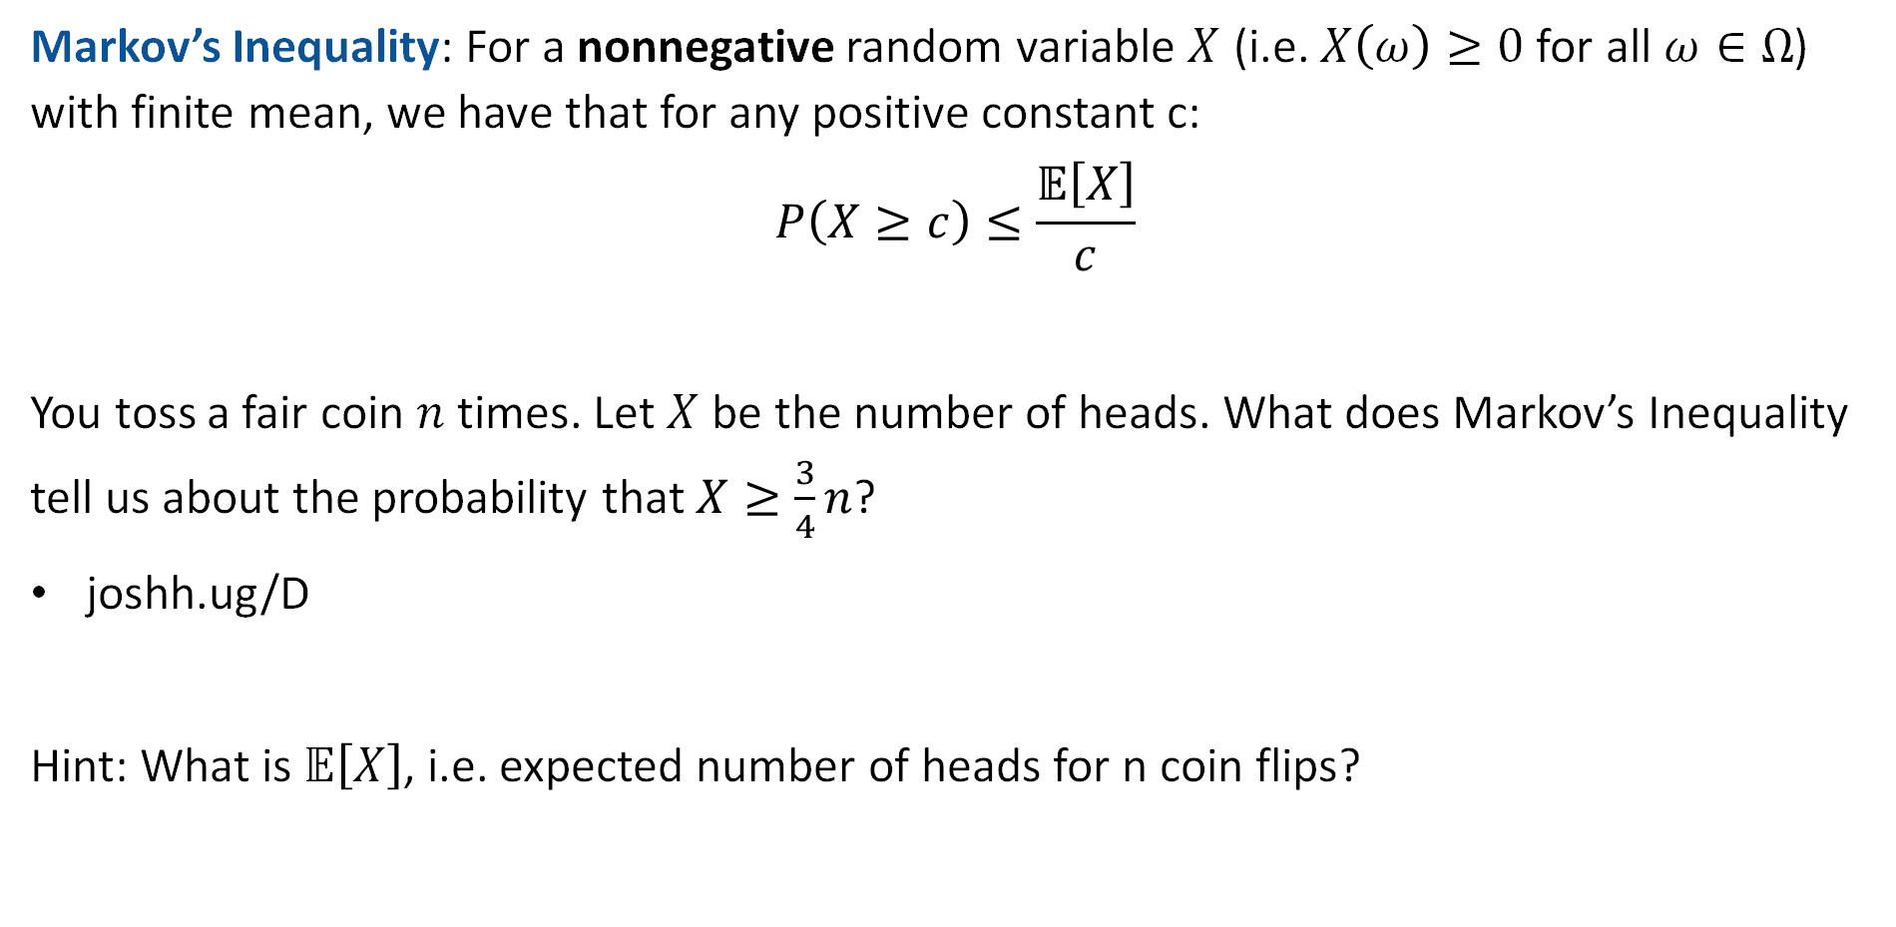
Example Using Markov’s Inequality: Coin Toss
Markov’s Inequality: For a nonnegative random variable $X$ (i.e. $X\left(ω\right)≥0$ for all $ω∈Ω$) with finite mean, we have that for any positive constant c:
$$P\left(X≥c\right)≤\frac{𝔼\left[X\right]}{c}$$
You toss a fair coin $n$ times. Let $X$ be the number of heads. What does Markov’s Inequality tell us about the probability that $X≥\frac{3}{4}n$?
joshh.ug/D
Hint: What is $𝔼\left[X\right]$, i.e. expected number of heads for n coin flips?

Slide 29
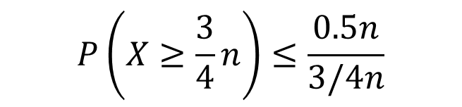
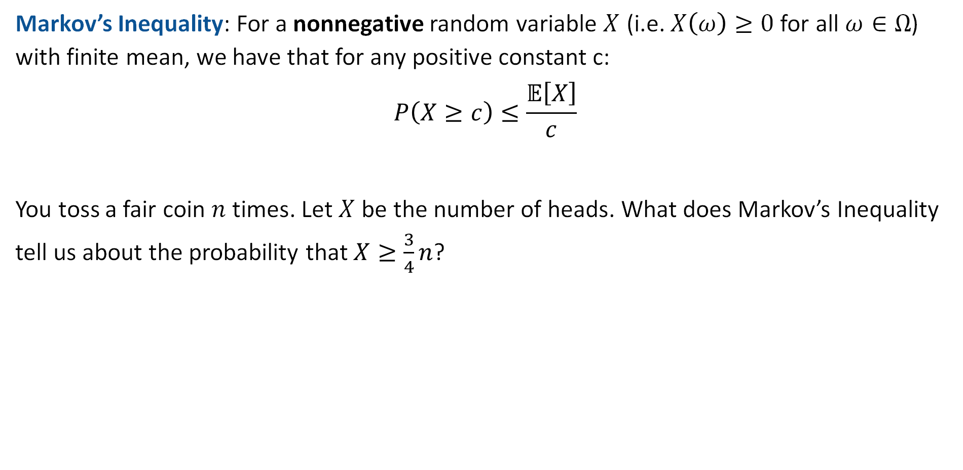


Example Using Markov’s Inequality: Coin Toss
Markov’s Inequality: For a nonnegative random variable $X$ (i.e. $X\left(ω\right)≥0$ for all $ω∈Ω$) with finite mean, we have that for any positive constant c:
$$P\left(X≥c\right)≤\frac{𝔼\left[X\right]}{c}$$
You toss a fair coin $n$ times. Let $X$ be the number of heads. What does Markov’s Inequality tell us about the probability that $X≥\frac{3}{4}n$?
$$P\left(X≥\frac{3}{4}n\right)≤\frac{0.5n}{3/4n}$$
$$𝔼\left[X\right]=0.5n$$
$$P\left(X≥\frac{3}{4}n\right)≤\frac{2}{3}$$

Slide 30


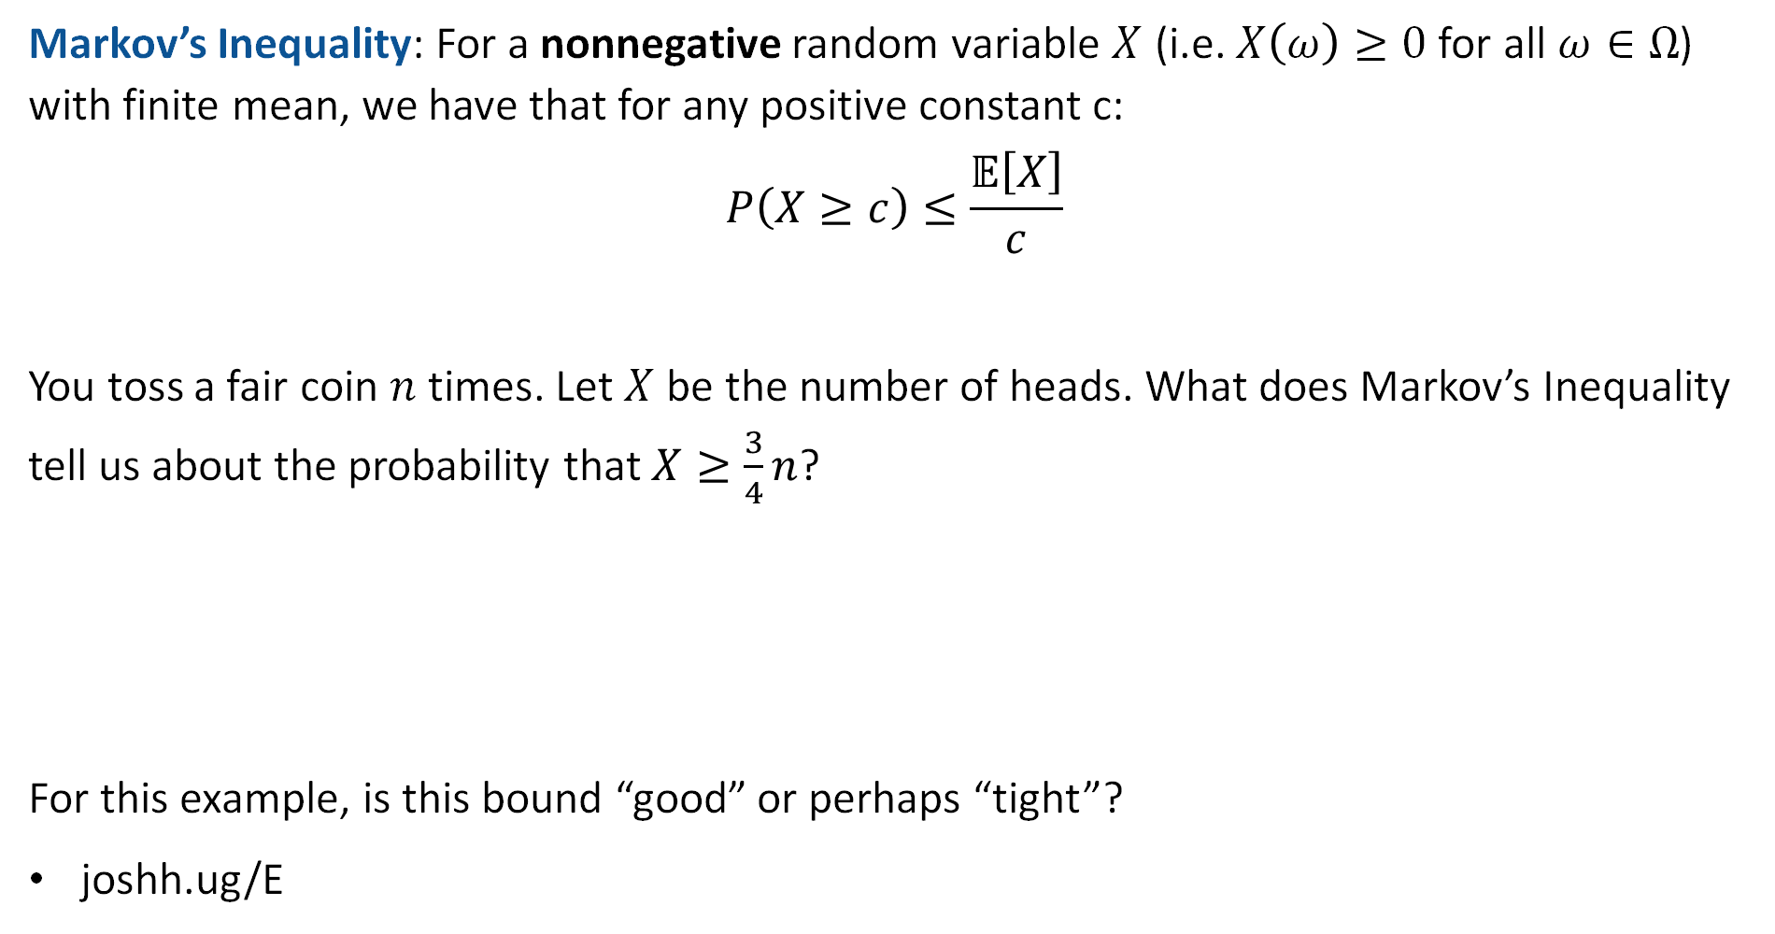
Example Using Markov’s Inequality: Coin Toss
Markov’s Inequality: For a nonnegative random variable $X$ (i.e. $X\left(ω\right)≥0$ for all $ω∈Ω$) with finite mean, we have that for any positive constant c:
$$P\left(X≥c\right)≤\frac{𝔼\left[X\right]}{c}$$
You toss a fair coin $n$ times. Let $X$ be the number of heads. What does Markov’s Inequality tell us about the probability that $X≥\frac{3}{4}n$?
For this example, is this bound “good” or perhaps “tight”?
joshh.ug/E
$$P\left(X≥\frac{3}{4}n\right)≤\frac{2}{3}$$

Slide 31
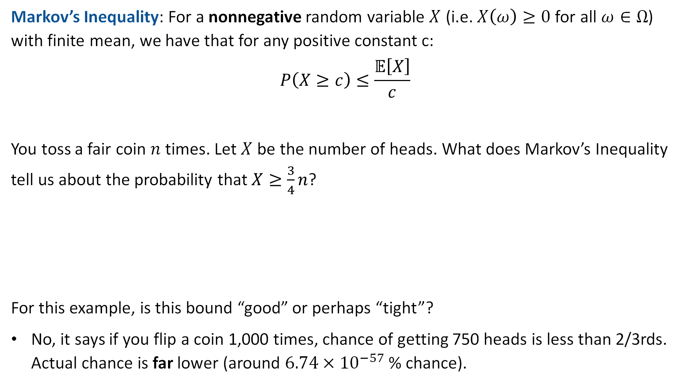
Example Using Markov’s Inequality: Coin Toss
Markov’s Inequality: For a nonnegative random variable $X$ (i.e. $X\left(ω\right)≥0$ for all $ω∈Ω$) with finite mean, we have that for any positive constant c:
$$P\left(X≥c\right)≤\frac{𝔼\left[X\right]}{c}$$
You toss a fair coin $n$ times. Let $X$ be the number of heads. What does Markov’s Inequality tell us about the probability that $X≥\frac{3}{4}n$?
For this example, is this bound “good” or perhaps “tight”?
No, it says if you flip a coin 1,000 times, chance of getting 750 heads is less than 2/3rds. Actual chance is far lower (around $6.74×{10}^{−57}$ % chance).
$$P\left(X≥\frac{3}{4}n\right)≤\frac{2}{3}$$

Slide 32
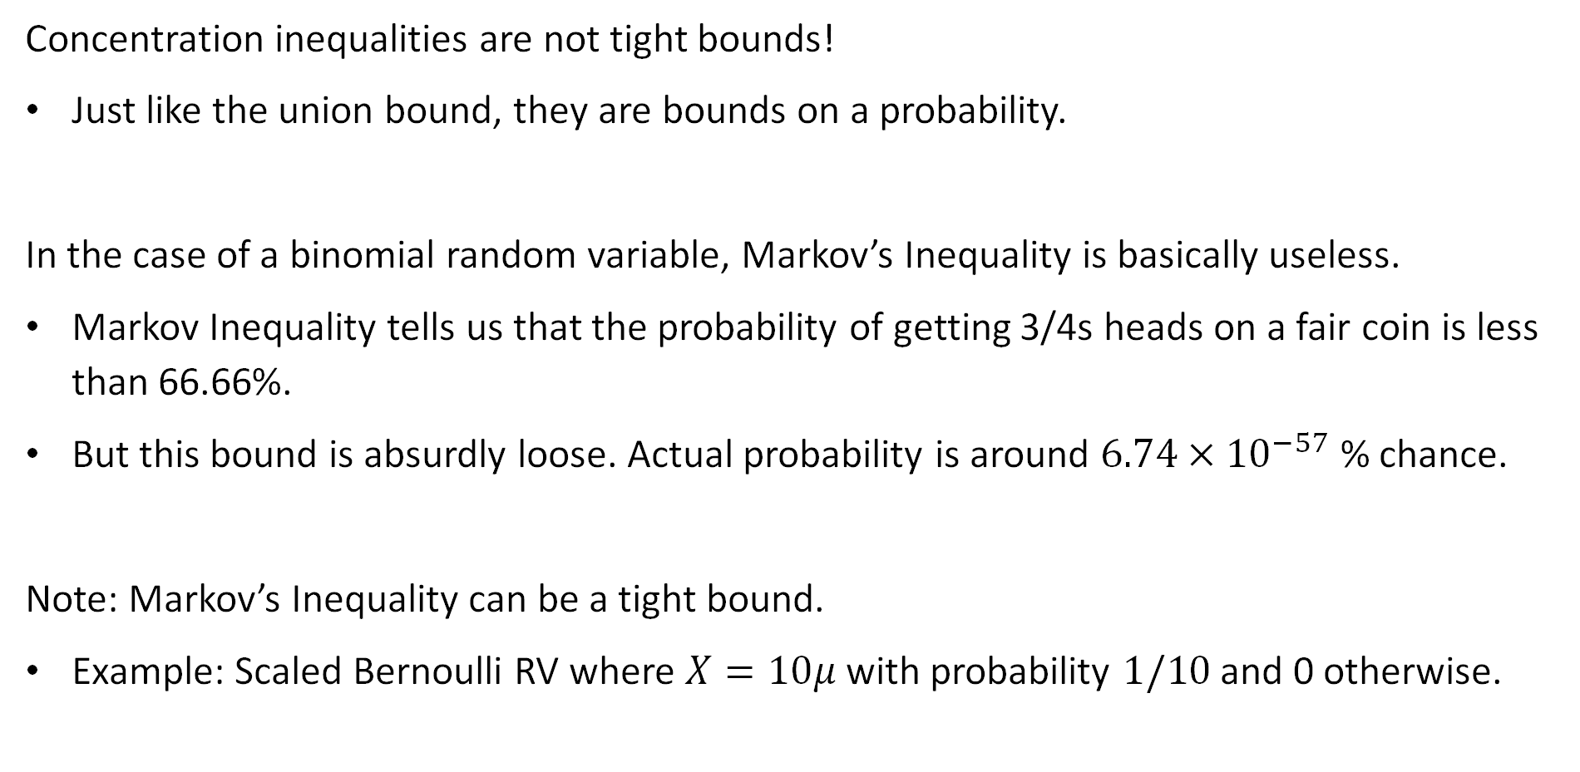
Concentration Inequalities and Bound Tightness
Concentration inequalities are not tight bounds!
Just like the union bound, they are bounds on a probability.
In the case of a binomial random variable, Markov’s Inequality is basically useless.
Markov Inequality tells us that the probability of getting 3/4s heads on a fair coin is less than 66.66%.
But this bound is absurdly loose. Actual probability is around $6.74×{10}^{−57}$ % chance.
Note: Markov’s Inequality can be a tight bound.
Example: Scaled Bernoulli RV where $X=10μ$ with probability $1/10$ and 0 otherwise.

Slide 33
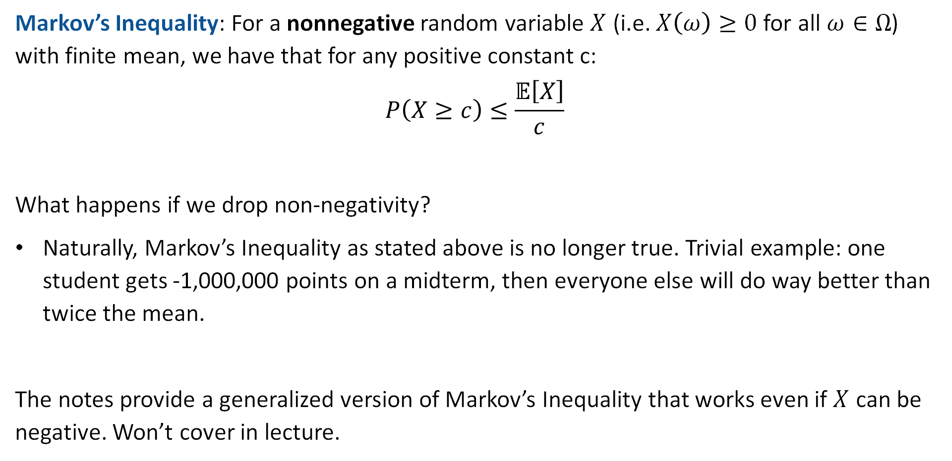
Markov’s Inequality
Markov’s Inequality: For a nonnegative random variable $X$ (i.e. $X\left(ω\right)≥0$ for all $ω∈Ω$) with finite mean, we have that for any positive constant c:
$$P\left(X≥c\right)≤\frac{𝔼\left[X\right]}{c}$$
What happens if we drop non-negativity?
Naturally, Markov’s Inequality as stated above is no longer true. Trivial example: one student gets -1,000,000 points on a midterm, then everyone else will do way better than twice the mean.
The notes provide a generalized version of Markov’s Inequality that works even if $X$ can be negative. Won’t cover in lecture.

Slide 34
Chebyshev’s Inequality
Estimating p for X~Bernoulli(p)
Markov’s Inequality
Chebyshev’s Inequality
The Chebyshev Bound for Number of Heads
The Chebyshev Bound for Estimating the Fairness of a Coin
Weak Law of Large Numbers
Bounds Beyond CS70
Lecture 22, CS70 Fall 2025

Slide 35
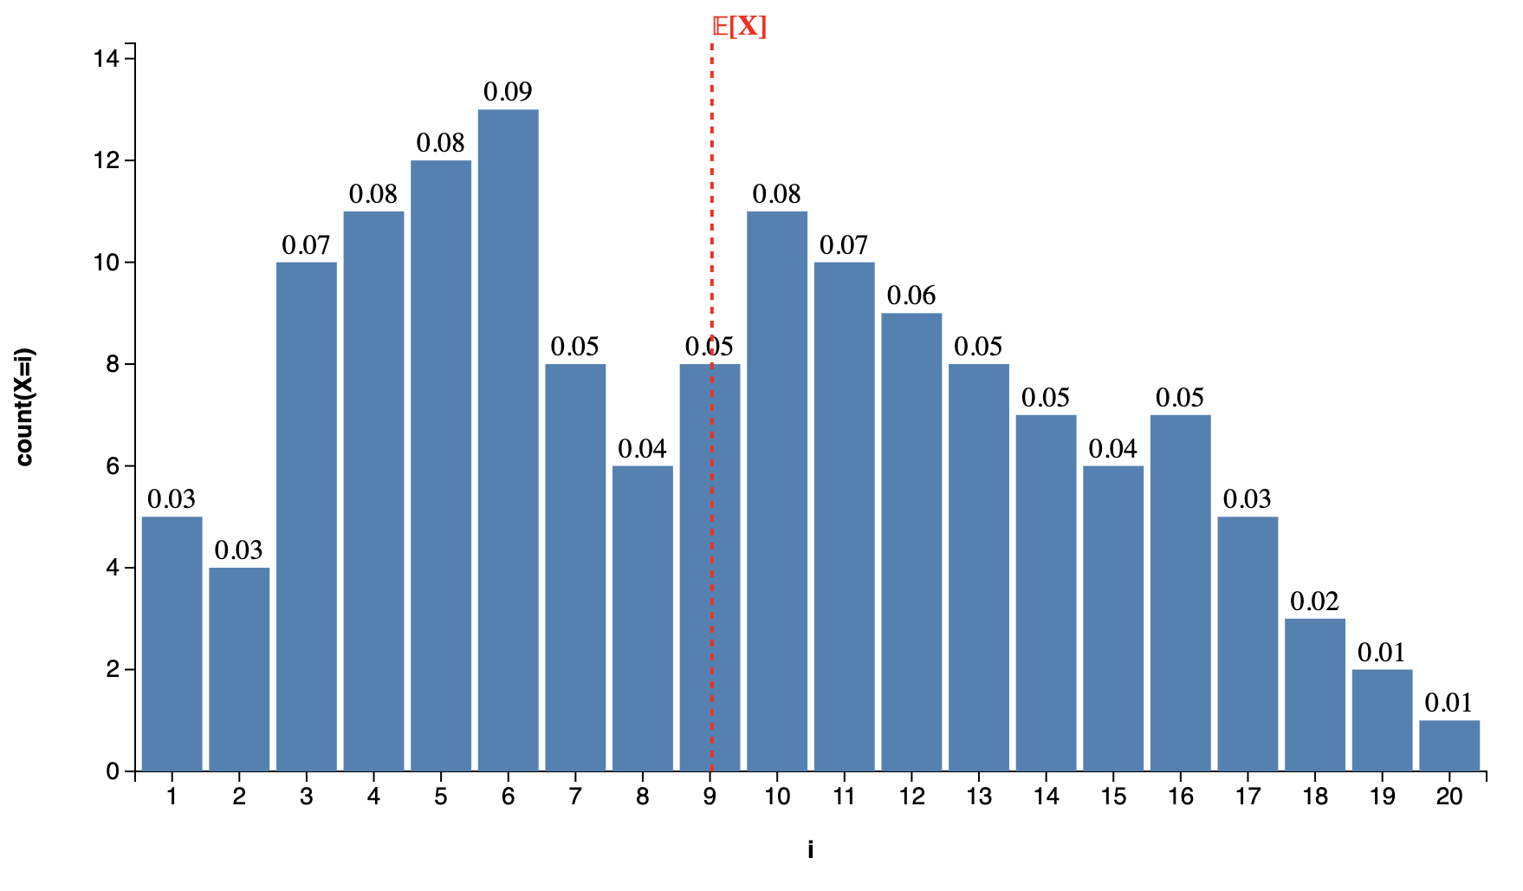
Expectations and Distributions (Visually)
Consider the distribution below.
We can think of the expectation as the “center of mass” of the distribution.
Each value has mass equal to the height of the respective bar.

Slide 36

Markov’s Inequality Visually
Markov’s inequality gives us a bound on how much mass there can be above some constant $c$. Example if $c=2𝔼\left[X\right]$ shown below.
$$P\left(X≥2𝔼\left[X\right]\right)≤1/2$$

Slide 37
Chebyshev’s Inequality Visually
Observation: It might be more useful to have an inequality that bounds the amount of mass that is far from the mean (in either direction).
$$P\left(\left|X−μ\right|≥c\right)≤ ??$$

Slide 38
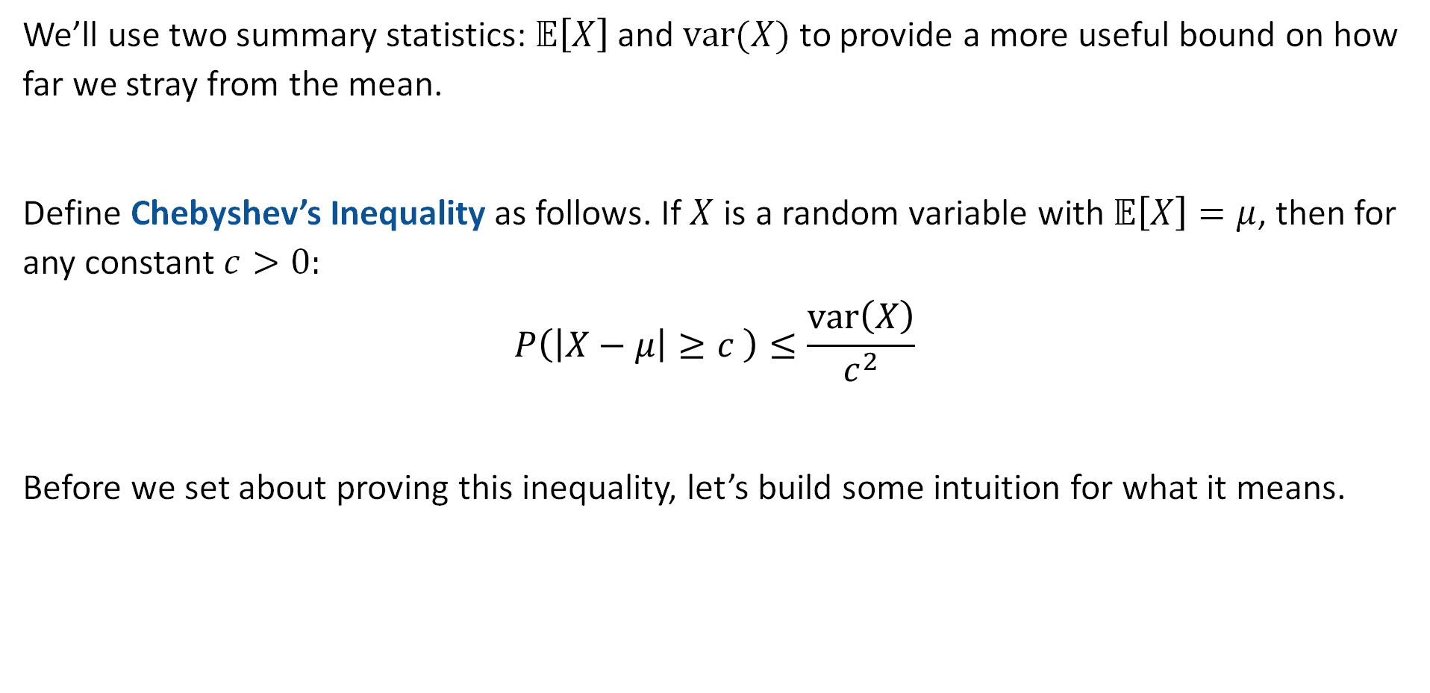
Chebyshev’s Inequality
We’ll use two summary statistics: $𝔼\left[X\right]$ and $var(X)$ to provide a more useful bound on how far we stray from the mean.
Define Chebyshev’s Inequality as follows. If $X$ is a random variable with $𝔼\left[X\right]=μ$, then for any constant $c>0:$
$$P\left(\left|X−μ\right|≥c \right)≤\frac{var\left(X\right)}{c^{2}}$$
Before we set about proving this inequality, let’s build some intuition for what it means.

Slide 39


Chebyshev’s Inequality: Intution 1, the Alternate Form
Define Chebyshev’s Inequality as follows. If $X$ is a random variable with $𝔼\left[X\right]=μ$, then for any constant $c>0:$
$$P\left(\left|X−μ\right|≥c \right)≤\frac{var\left(X\right)}{c^{2}}$$
Suppose we pick the constant $c=kσ$, what is the upper bound?
joshh.ug/F
$$P\left(\left|X−μ\right|≥kσ\right)≤ ??$$

Slide 40
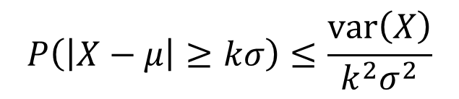




Chebyshev’s Inequality
Define Chebyshev’s Inequality as follows. If $X$ is a random variable with $𝔼\left[X\right]=μ$, then for any constant $c>0:$
$$P\left(\left|X−μ\right|≥c \right)≤\frac{var\left(X\right)}{c^{2}}$$
Suppose we pick the constant $c=kσ$, what is the upper bound?
$$P\left(\left|X−μ\right|≥kσ\right)≤\frac{var\left(X\right)}{k^{2}σ^{2}}$$
$$=\frac{σ^{2}}{k^{2}σ^{2}}$$
$$=\frac{1}{k^{2}}$$
$$P\left(\left|X−μ\right|≥kσ\right)≤\frac{1}{k^{2}}$$

Slide 41

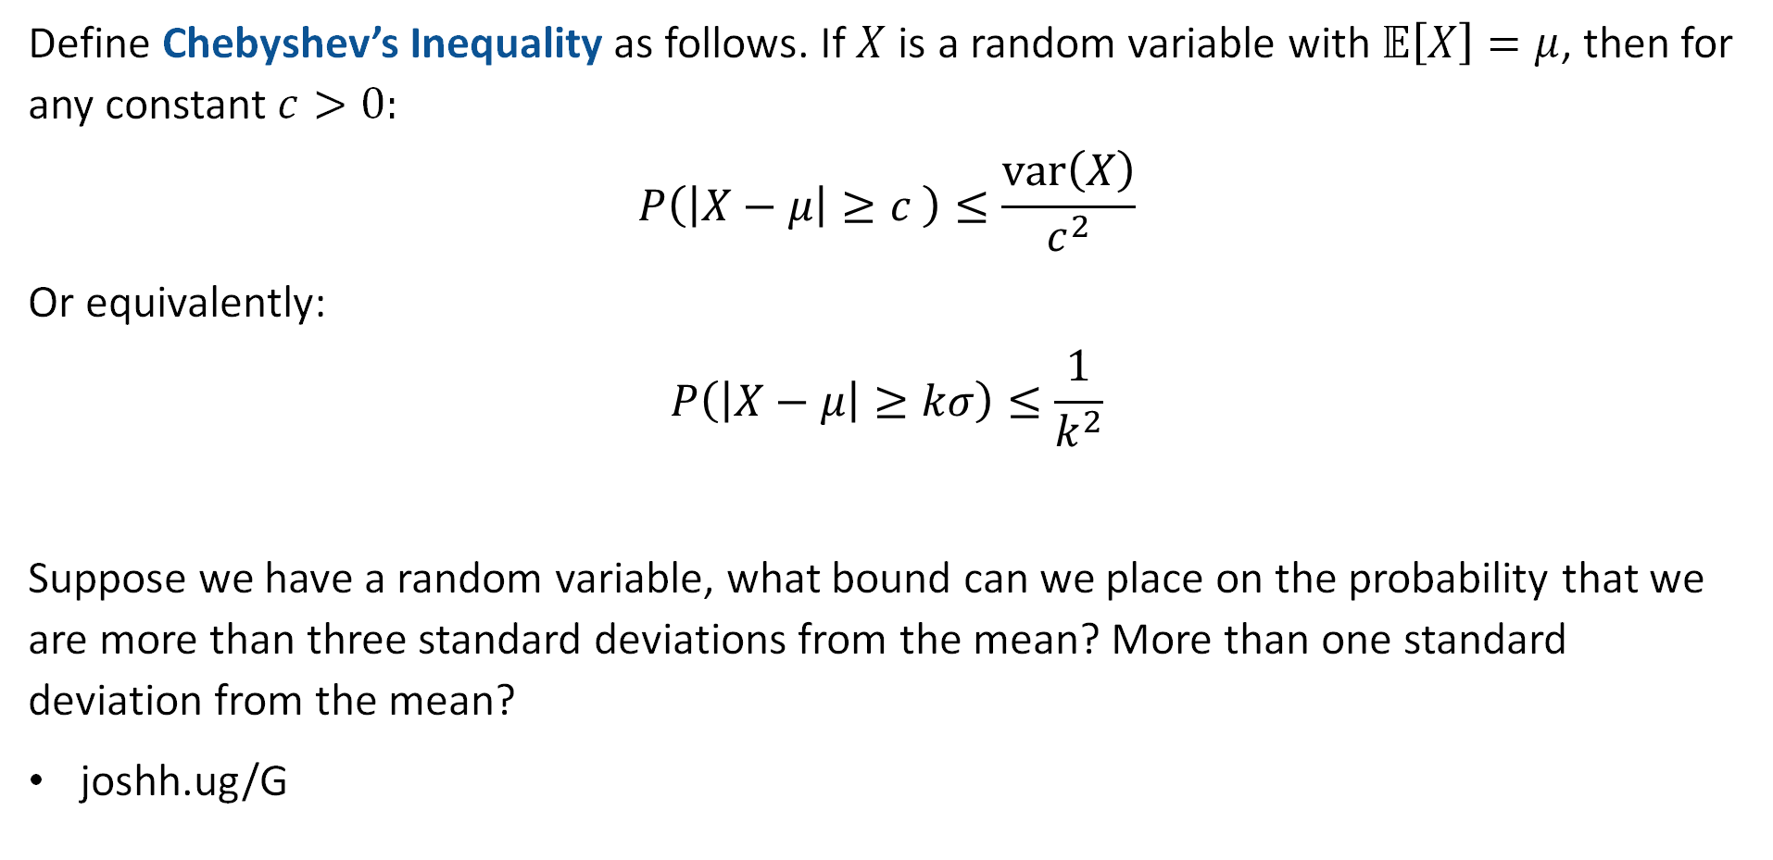
Chebyshev’s Inequality
Define Chebyshev’s Inequality as follows. If $X$ is a random variable with $𝔼\left[X\right]=μ$, then for any constant $c>0:$
$$P\left(\left|X−μ\right|≥c \right)≤\frac{var\left(X\right)}{c^{2}}$$
Or equivalently:
$$P\left(\left|X−μ\right|≥kσ\right)≤\frac{1}{k^{2}}$$
Suppose we have a random variable, what bound can we place on the probability that we are more than three standard deviations from the mean? More than one standard deviation from the mean?
joshh.ug/G

Slide 42
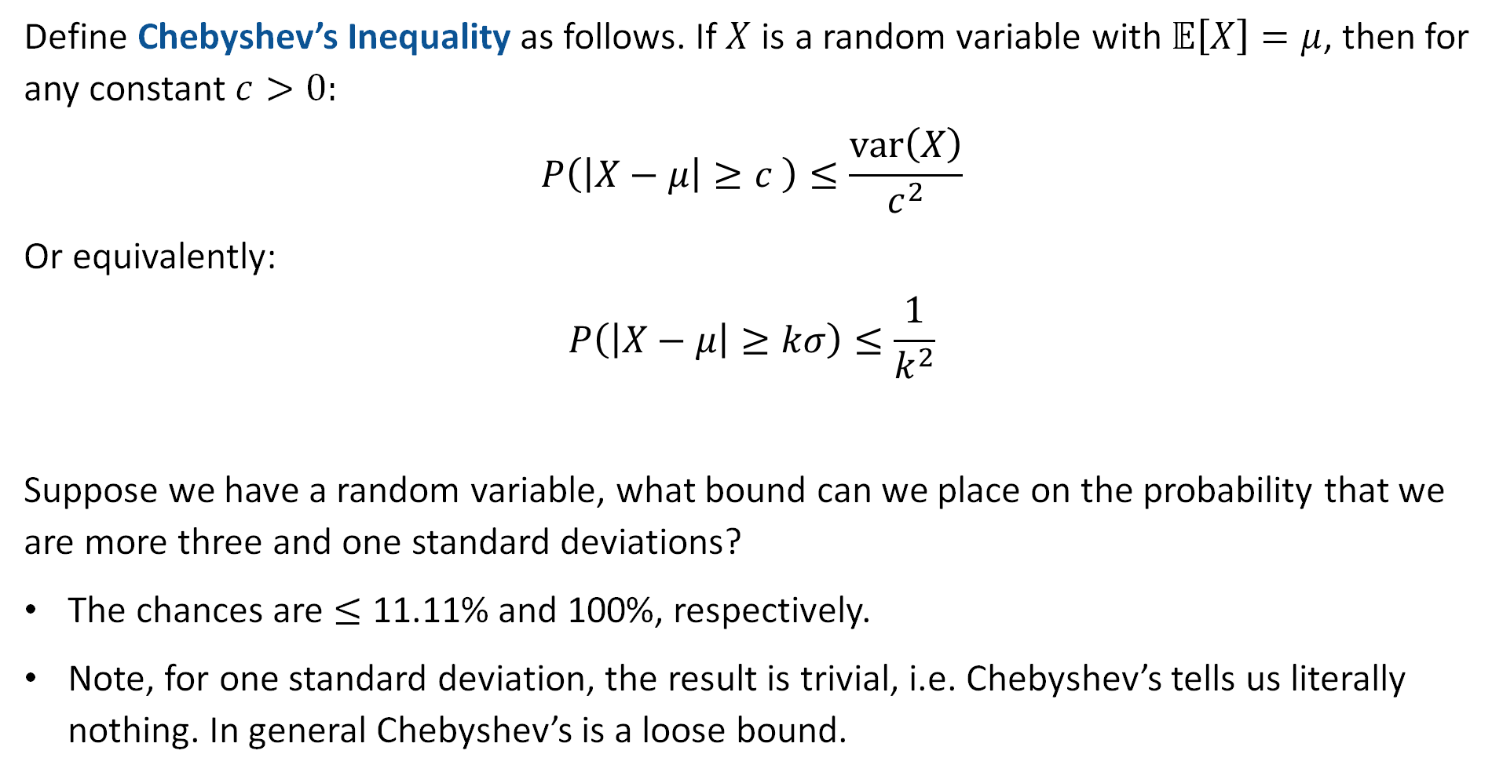
Chebyshev’s Inequality
Define Chebyshev’s Inequality as follows. If $X$ is a random variable with $𝔼\left[X\right]=μ$, then for any constant $c>0:$
$$P\left(\left|X−μ\right|≥c \right)≤\frac{var\left(X\right)}{c^{2}}$$
Or equivalently:
$$P\left(\left|X−μ\right|≥kσ\right)≤\frac{1}{k^{2}}$$
Suppose we have a random variable, what bound can we place on the probability that we are more three and one standard deviations?
The chances are $≤$ 11.11% and 100%, respectively.
Note, for one standard deviation, the result is trivial, i.e. Chebyshev’s tells us literally nothing. In general Chebyshev’s is a loose bound.

Slide 43
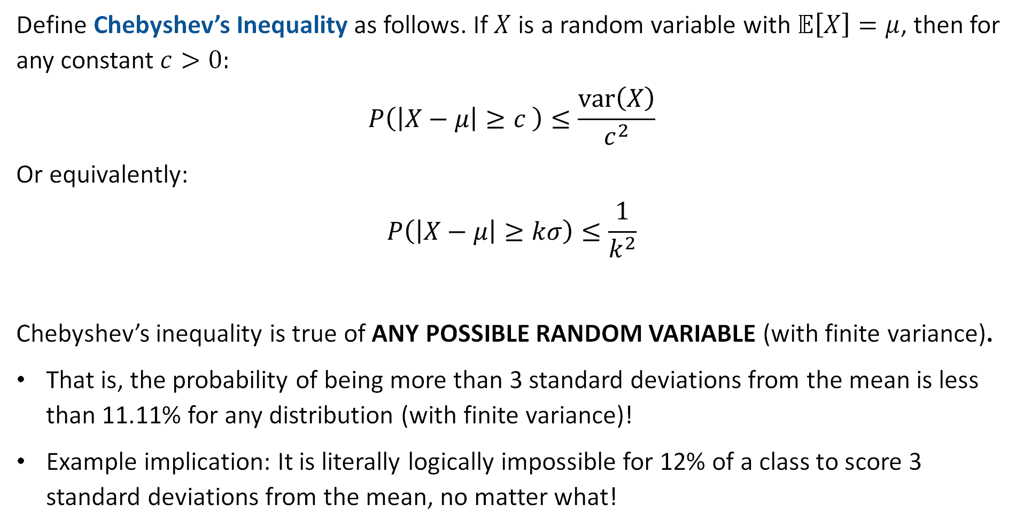
Chebyshev’s Inequality
Define Chebyshev’s Inequality as follows. If $X$ is a random variable with $𝔼\left[X\right]=μ$, then for any constant $c>0:$
$$P\left(\left|X−μ\right|≥c \right)≤\frac{var\left(X\right)}{c^{2}}$$
Or equivalently:
$$P\left(\left|X−μ\right|≥kσ\right)≤\frac{1}{k^{2}}$$
Chebyshev’s inequality is true of ANY POSSIBLE RANDOM VARIABLE (with finite variance).
That is, the probability of being more than 3 standard deviations from the mean is less than 11.11% for any distribution (with finite variance)!
Example implication: It is literally logically impossible for 12% of a class to score 3 standard deviations from the mean, no matter what!

Slide 44
Chebyshev’s is Still a Loose Bound: Normal Distribution Example
There’s a distribution we’ll talk about next week called the normal distribution.
Probability that you are less than 3 standard deviations from the mean is 99.7%.
Or equivalently: Probability that are you are more than 3 standard deviations from the mean is 0.3%.
Chebyshev’s is considerably looser. It says the probability of being more than 3 standard deviations from the mean is 11.1%
Key difference: Chebyshev is true of all possible distributions. The 99.7% rule is only for the Normal.

Slide 45
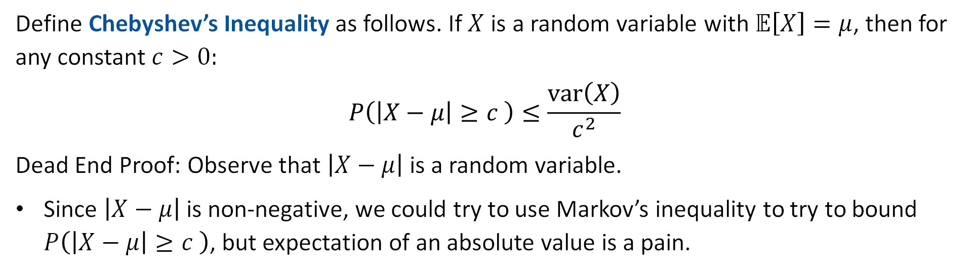
Chebyshev Proof
Define Chebyshev’s Inequality as follows. If $X$ is a random variable with $𝔼\left[X\right]=μ$, then for any constant $c>0:$
$$P\left(\left|X−μ\right|≥c \right)≤\frac{var\left(X\right)}{c^{2}}$$
Dead End Proof: Observe that $\left|X−μ\right|$ is a random variable.
Since $\left|X−μ\right|$ is non-negative, we could try to use Markov’s inequality to try to bound $P\left(\left|X−μ\right|≥c \right)$, but expectation of an absolute value is a pain.

Slide 46
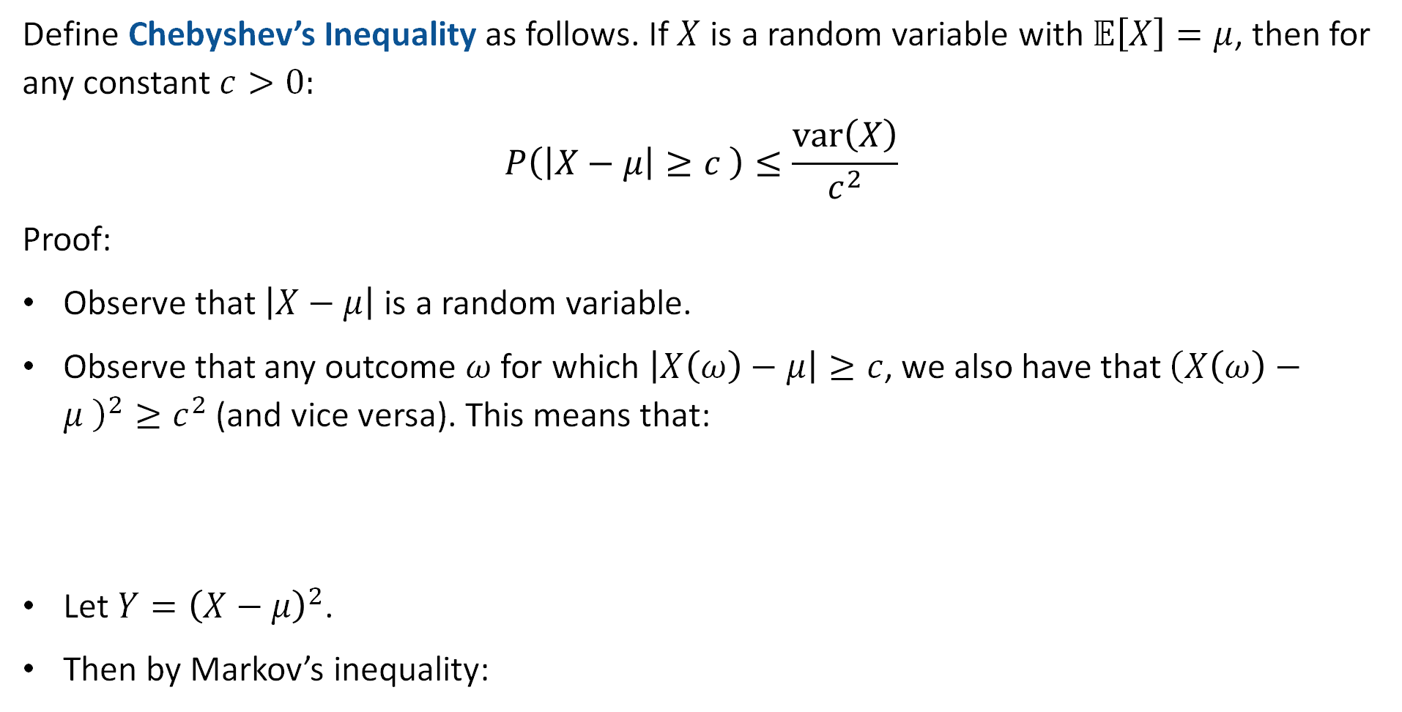
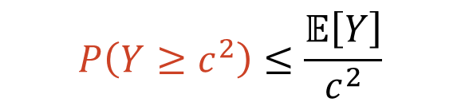
Chebyshev Proof
Define Chebyshev’s Inequality as follows. If $X$ is a random variable with $𝔼\left[X\right]=μ$, then for any constant $c>0:$
$$P\left(\left|X−μ\right|≥c \right)≤\frac{var\left(X\right)}{c^{2}}$$
Proof:
Observe that $\left|X−μ\right|$ is a random variable.
Observe that any outcome $ω$ for which $\left|X\left(ω\right)−μ\right|≥c$, we also have that ${\left(X\left(ω\right)−μ \right)}^{2}≥c^{2}$ (and vice versa). This means that:
Let $Y={\left(X−μ\right)}^{2}$.
Then by Markov’s inequality:
$$P\left(\left|X−μ\right|≥c \right)=P\left({\left(X−μ\right)}^{2}≥c^{2} \right)$$
$$P\left(Y≥c^{2}\right)≤\frac{𝔼\left[Y\right]}{c^{2}}$$

Slide 47

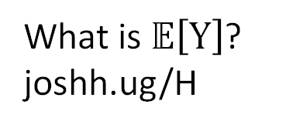
Chebyshev Proof
Define Chebyshev’s Inequality as follows. If $X$ is a random variable with $𝔼\left[X\right]=μ$, then for any constant $c>0:$
$$P\left(\left|X−μ\right|≥c \right)≤\frac{var\left(X\right)}{c^{2}}$$
Proof:
Observe that $\left|X−μ\right|$ is a random variable.
Observe that any outcome $ω$ for which $\left|X\left(ω\right)−μ\right|≥c$, we also have that ${\left(X\left(ω\right)−μ \right)}^{2}≥c^{2}$ (and vice versa). This means that:
Let $Y={\left(X−μ\right)}^{2}$.
Then by Markov’s inequality:
$$P\left(\left|X−μ\right|≥c \right)=P\left({\left(X−μ\right)}^{2}≥c^{2} \right)$$
$$P\left(Y≥c^{2}\right)≤\frac{𝔼\left[Y\right]}{c^{2}}$$
What is $𝔼\left[Y\right]$?
joshh.ug/H

Slide 48
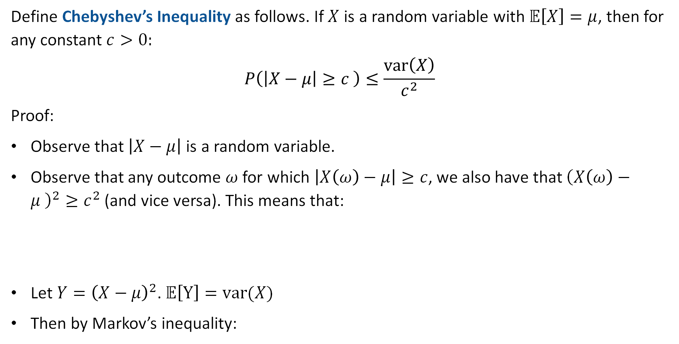

Chebyshev Proof
Define Chebyshev’s Inequality as follows. If $X$ is a random variable with $𝔼\left[X\right]=μ$, then for any constant $c>0:$
$$P\left(\left|X−μ\right|≥c \right)≤\frac{var\left(X\right)}{c^{2}}$$
Proof:
Observe that $\left|X−μ\right|$ is a random variable.
Observe that any outcome $ω$ for which $\left|X\left(ω\right)−μ\right|≥c$, we also have that ${\left(X\left(ω\right)−μ \right)}^{2}≥c^{2}$ (and vice versa). This means that:
Let $Y={\left(X−μ\right)}^{2}$. $𝔼\left[Y\right]=var(X)$
Then by Markov’s inequality:
$$P\left(\left|X−μ\right|≥c \right)=P\left({\left(X−μ\right)}^{2}≥c^{2} \right)$$
$$P\left(Y≥c^{2}\right)≤\frac{𝔼\left[Y\right]}{c^{2}}$$
$$=\frac{var\left(X\right)}{c^{2}}$$

Slide 49
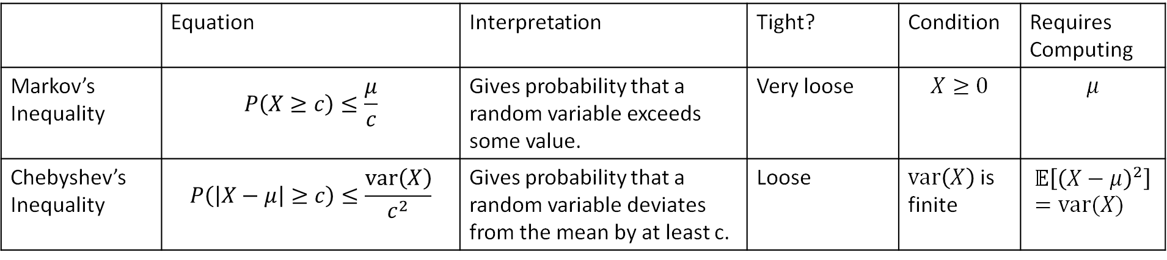

Chebyshev’s Inequality and Markov’s Inequality
Even though Markov’s Inequality is weak for understanding $X$, we were able to enhance its power by considering a new random variable $Y={\left(X−μ\right)}^{2}$ and applying Markov’s Inequality bound on this new variable.
Since $𝔼\left[Y\right]=𝔼\left[{\left(X−μ\right)}^{2}\right]=var(X)$, our resulting bound was in terms of the variance.
 | Equation | Interpretation | Tight? | Condition | Requires Computing
Markov’s Inequality | $$P\left(X≥c\right)≤\frac{μ}{c}$$ | Gives probability that a random variable exceeds some value. | Very loose | $$X≥0$$ | $$μ$$
Chebyshev’s Inequality | $$P\left(\left|X−μ\right|≥c\right)≤\frac{var\left(X\right)}{c^{2}}$$ | Gives probability that a random variable deviates from the mean by at least c. | Loose | $var\left(X\right)$ is finite | $$𝔼\left[{\left(X−μ\right)}^{2}\right]=var(X)$$

Slide 50


Chebyshev’s Inequality and Markov’s Inequality
Even though Markov’s Inequality is weak for understanding $X$, we were able to enhance its power by considering a new random variable $Y={\left(X−μ\right)}^{2}$ and applying Markov’s Inequality bound on this new variable.
Yes, you can enhance the bound further by making up new random variables such as ${Z=\left(X−μ\right)}^{10}$, but then you need to be able to compute $𝔼\left[{\left(X−μ\right)}^{10}\right]$.
We call $𝔼\left[{\left(X−μ\right)}^{i}\right]$ the ith “moment” of $X$ (beyond the scope of 70).
On the homework you’ll derive the bound if you use infinite moments from $i=\{1,2…\}$
 | Equation | Interpretation | Tight? | Condition | Requires Computing
Markov’s Inequality | $$P\left(X≥c\right)≤\frac{μ}{c}$$ | Gives probability that a random variable exceeds some value. | Very loose | $$X≥0$$ | $$μ$$
Chebyshev’s Inequality | $$P\left(\left|X−μ\right|≥c\right)≤\frac{var\left(X\right)}{c^{2}}$$ | Gives probability that a random variable deviates from the mean by at least c. | Loose | $var\left(X\right)$ is finite | $$𝔼\left[{\left(X−μ\right)}^{2}\right]=var(X)$$

Slide 51
The Chebyshev Bound for Estimating Probability of a Coin Flip Event
Estimating p for X~Bernoulli(p)
Markov’s Inequality
Chebyshev’s Inequality
The Chebyshev Bound for Number of Heads
The Chebyshev Bound for Estimating the Fairness of a Coin
Weak Law of Large Numbers
Bounds Beyond CS70
Lecture 22, CS70 Fall 2025

Slide 52

Application: Probability of Coin Toss Outcomes
Earlier, we tried to use Markov’s Inequality to understand the behavior of $X\sim Binomial(n, 0.5)$.
Specifically, we asked: What is the chance that at least 3/4s of our flips come up heads.
Using Markov’s Inequality, we found that $\left(X≥\frac{3}{4}n\right)≤\frac{2}{3}$.
This bound was not useful! As we flip more coins, the actual probability drops.
If we use Chebyshev’s Inequality instead, we’ll see a dependence on $n$.

Slide 53









Application: Probability of Coin Toss Outcomes
For $X\sim Binomial(n, 0.5)$, let’s bound $P\left(X≥\frac{3}{4}n\right)$, using Chebyshev’s Inequality: If $X$ is a random variable with $𝔼\left[X\right]=μ$, then for any constant $c>0:$
$$P\left(\left|X−μ\right|≥c\right)≤\frac{var\left(X\right)}{c^{2}}$$
First, we write expectation and variance:
Then, get
$$𝔼\left[X\right]=μ=\frac{n}{2}$$
$$var\left(X\right)=n⋅p⋅\left(1−p\right)=\frac{n}{4}$$
$$P\left(X≥\frac{3}{4}n\right)$$
into the appropriate form to apply Chebyshev:
$$P\left(X≥\frac{3}{4}n\right)=P\left(X−μ≥\frac{3}{4}n−μ\right)$$
$$=P\left(X−μ≥\frac{n}{4}\right)$$
$$≤\frac{var\left(X\right)}{{\left(\frac{n}{4}\right)}^{2}}$$
$$=P\left(X−𝔼\left[X\right]≥\frac{1}{4}n\right)$$
$$=\frac{4}{n}$$

Slide 54
Application: Probability of Coin Toss Outcomes
For $X\sim Binomial(n, 0.5)$, let’s bound $P\left(X≥\frac{3}{4}n\right)$, using Chebyshev’s Inequality: If $X$ is a random variable with $𝔼\left[X\right]=μ$, then for any constant $c>0:$
$$P\left(\left|X−μ\right|≥c\right)≤\frac{var\left(X\right)}{c^{2}}$$
First, we write expectation and variance:
Then, get
$$𝔼\left[X\right]=μ=\frac{n}{2}$$
$$var\left(X\right)=n⋅p⋅\left(1−p\right)=\frac{n}{4}$$
$$P\left(X≥\frac{3}{4}n\right)$$
into the appropriate form to apply Chebyshev:
$$P\left(X≥\frac{3}{4}n\right)=P\left(X−μ≥\frac{3}{4}n−μ\right)$$
$$=P\left(X−μ≥\frac{n}{4}\right)$$
We are close! What is the relationship between $P\left(X−μ≥\frac{n}{4}\right)$ and $P\left(\left|X−μ\right|≥\frac{n}{4}\right)$?
$$≤\frac{var\left(X\right)}{{\left(\frac{n}{4}\right)}^{2}}$$
$$=P\left(X−𝔼\left[X\right]≥\frac{1}{4}n\right)$$
$$=\frac{4}{n}$$

Slide 55
Application: Probability of Coin Toss Outcomes
For $X\sim Binomial(n, 0.5)$, let’s bound $P\left(X≥\frac{3}{4}n\right)$, using Chebyshev’s Inequality: If $X$ is a random variable with $𝔼\left[X\right]=μ$, then for any constant $c>0:$
$$P\left(\left|X−μ\right|≥c\right)≤\frac{var\left(X\right)}{c^{2}}$$
First, we write expectation and variance:
Then, get
$$𝔼\left[X\right]=μ=\frac{n}{2}$$
$$var\left(X\right)=n⋅p⋅\left(1−p\right)=\frac{n}{4}$$
$$P\left(X≥\frac{3}{4}n\right)$$
into the appropriate form to apply Chebyshev:
$$P\left(X≥\frac{3}{4}n\right)=P\left(X−μ≥\frac{3}{4}n−μ\right)$$
$$=P\left(X−μ≥\frac{n}{4}\right)$$
We know that $P\left(X−μ≥\frac{n}{4}\right)≤P\left(\left|X−μ\right|≥\frac{n}{4}\right)$.
$$≤\frac{var\left(X\right)}{{\left(\frac{n}{4}\right)}^{2}}$$
$$=P\left(X−𝔼\left[X\right]≥\frac{1}{4}n\right)$$
$$=\frac{4}{n}$$

Slide 56







Application: Probability of Coin Toss Outcomes
For $X\sim Binomial(n, 0.5)$, let’s bound $P\left(X≥\frac{3}{4}n\right)$, using Chebyshev’s Inequality: If $X$ is a random variable with $𝔼\left[X\right]=μ$, then for any constant $c>0:$
$$P\left(\left|X−μ\right|≥c\right)≤\frac{var\left(X\right)}{c^{2}}$$
First, we write expectation and variance:
Then,
$$𝔼\left[X\right]=μ=\frac{n}{2}$$
$$var\left(X\right)=n⋅p⋅\left(1−p\right)=\frac{n}{4}$$
$$P\left(X≥\frac{3}{4}n\right)$$
$$≤P\left(\left|X−μ\right|≥\frac{n}{4}\right)$$
We’re in the right form, so now we just apply Chebyshev’s Inequality.
$$≤\frac{var\left(X\right)}{c^{2}}$$
$$=\frac{var\left(X\right)}{{\left(\frac{n}{4}\right)}^{2}}$$
$$=\frac{n/4}{{\left(\frac{n}{4}\right)}^{2}}$$
$$=\frac{4}{n}$$

Slide 57


Interpretation in Terms of Voting
For $X\sim Binomial(n, 0.5)$, let’s bound $P\left(X≥\frac{3}{4}n\right)$, using Chebyshev’s Inequality: If $X$ is a random variable with $𝔼\left[X\right]=μ$, then for any constant $c>0:$
$$P\left(\left|X−μ\right|≥c\right)≤\frac{var\left(X\right)}{c^{2}}$$
Our Chebyshev bound is:
Example: In an election where the chance of voting for candidate A is $p=0.5$.
Chebyshev bound says the chance of getting 75% of the vote is less than 0.04% if 1000 people vote.
But this is a somewhat silly use of the Chebyshev bound, we already know how to compute this chance exactly (and it’s much smaller than 0.04%).
Let’s instead use Chebyshev in a more useful way: Estimating $p$ itself.
$$P\left(X≥\frac{3}{4}n\right)≤\frac{4}{n}$$

Slide 58








Back to Estimating $p$ for a Coin
Let’s go back to where we started today. Suppose We have a coin with unknown heads probability $p$. We estimate it by tossing a coin n times.
$X$ is the number of heads. $X=X_{1}+X_{2}+…+X_{n}$.
Our empirical mean is
Goal: How big does $n$ need to be so that $P\left(\left|\hat{p}−p\right|≥ε\right)≤δ$
Observation, we can bound using Chebyshev’s inequality.
To show this, we’ll need $𝔼[\hat{p}]$.
$$\hat{p}=\frac{X}{n}$$
$$P\left(\left|\hat{p}−p\right|≥ε\right)$$
$$=𝔼\left[\frac{X}{n}\right]$$
$$=\frac{1}{n}𝔼\left[X\right]$$
$$=\frac{pn}{n}$$
$$𝔼\left[\hat{p}\right]$$
$$=p$$

Slide 59
The Chebyshev Bound for Estimating the Fairness of a Coin
Estimating p for X~Bernoulli(p)
Markov’s Inequality
Chebyshev’s Inequality
The Chebyshev Bound for Number of Heads
The Chebyshev Bound for Estimating the Fairness of a Coin
Weak Law of Large Numbers
Bounds Beyond CS70
Lecture 22, CS70 Fall 2025

Slide 60

Back to Estimating $p$ for a Coin
Let’s go back to where started today
Suppose we want to create an estimate $\hat{p}$ for the true heads probability $p$.
How many times do we need to flip the coin so that we the chance $C$ of being within $ε$ of the true p
$$P\left(\left|\hat{p}−p\right|≥ε\right)≥C$$

Slide 61

Back to Where We Started: Estimating $p$ for a Coin
We have a coin with unknown heads probability $p$. We estimate it by tossing a coin n times.
$X$ is the number of heads. $X=X_{1}+X_{2}+…+X_{n}$.
Our empirical mean is
Goal: How big does $n$ need to be so that $P\left(\left|\hat{p}−p\right|≤ε\right)≥C$?
In other words, how big does $n$ need to be so that we have at least a $C$ chance of being within $ε$ of the true $p$?
Can reframe as finding $n$ such $P\left(\left|\hat{p}−p\right|≥ε\right)$ $≤δ$
Why? Let’s do a quick (but tedious) transformation.
$$\hat{p}=\frac{X}{n}$$

Slide 62

Back to Where We Started: Estimating $p$ for a Coin
We have a coin with unknown heads probability $p$. We estimate it by tossing a coin n times.
$X$ is the number of heads. $X=X_{1}+X_{2}+…+X_{n}$.
Our empirical mean is
Goal: How big does $n$ need to be so that $P\left(\left|\hat{p}−p\right|≤ε\right)≥C$?
In other words, how big does $n$ need to be so that we have at least a $C$ chance of being within $ε$ of the true $p$?
First, let’s recast in terms our acceptable failure rate $δ$.
We know that $C=1−δ$.
$$\hat{p}=\frac{X}{n}$$

Slide 63

Back to Estimating $p$ for a Coin
We have a coin with unknown heads probability $p$. We estimate it by tossing a coin n times.
$X$ is the number of heads. $X=X_{1}+X_{2}+…+X_{n}$.
Our empirical mean is
Goal: How big does $n$ need to be so that $P\left(\left|\hat{p}−p\right|≤ε\right)≥1−δ$?
In other words, how big does $n$ need to be so that we have at least a $1−δ$ chance of being within $ε$ of the true $p$?
$$\hat{p}=\frac{X}{n}$$

Slide 64

Back to Estimating $p$ for a Coin
We have a coin with unknown heads probability $p$. We estimate it by tossing a coin n times.
$X$ is the number of heads. $X=X_{1}+X_{2}+…+X_{n}$.
Our empirical mean is
Goal: How big does $n$ need to be so that $P\left(\left|\hat{p}−p\right|≤ε\right)≥1−δ$?
In other words, how big does $n$ need to be so that we have at least a $1−δ$ chance of being within $ε$ of the true $p$?
Next, we observe that if $P\left(\left|\hat{p}−p\right|≤ε\right)≥1−δ$, then $P\left(\left|\hat{p}−p\right|>ε\right)≤δ$
$$\hat{p}=\frac{X}{n}$$

Slide 65

Back to Estimating $p$ for a Coin
We have a coin with unknown heads probability $p$. We estimate it by tossing a coin n times.
$X$ is the number of heads. $X=X_{1}+X_{2}+…+X_{n}$.
Our empirical mean is
Goal: How big does $n$ need to be so that $P\left(\left|\hat{p}−p\right|≤ε\right)≥1−δ$?
In other words, how big does $n$ need to be so that we have at least a $1−δ$ chance of being within $ε$ of the true $p$?
Next, we observe that if $P\left(\left|\hat{p}−p\right|≤ε\right)≥1−δ$, then $P\left(\left|\hat{p}−p\right|>ε\right)≤δ$
Why? $1−δ$ chance of being within $ε$ of the true value is the same thing as a $δ$ chance of being more than $ε$ away from the true value.
$$\hat{p}=\frac{X}{n}$$

Slide 66

Back to Estimating $p$ for a Coin
We have a coin with unknown heads probability $p$. We estimate it by tossing a coin n times.
$X$ is the number of heads. $X=X_{1}+X_{2}+…+X_{n}$.
Our empirical mean is
Goal: How big does $n$ need to be so that $P\left(\left|\hat{p}−p\right|>ε\right)≤δ$?
In other words, how big does $n$ need to be so that we have a no more than $δ$chance of being more than $ε$ away from the true $p$?
Lastly we note that for any $n$ such that $P\left(\left|\hat{p}−p\right|≥ε\right)≤δ$, we also have have that $P\left(\left|\hat{p}−p\right|>ε\right)≤δ$.
This is because $P\left(\left|\hat{p}−p\right|>ε\right)≤P\left(\left|\hat{p}−p\right|≥ε\right)$
$$\hat{p}=\frac{X}{n}$$

Slide 67

Back to Estimating $p$ for a Coin
We have a coin with unknown heads probability $p$. We estimate it by tossing a coin n times.
$X$ is the number of heads. $X=X_{1}+X_{2}+…+X_{n}$.
Our empirical mean is
Goal: How big does $n$ need to be so that $P\left(\left|\hat{p}−p\right|≤ε\right)≥C$?
We’ve now shown that we can reframe as finding $n$ such $P\left(\left|\hat{p}−p\right|≥ε\right)$
$$\hat{p}=\frac{X}{n}$$

Slide 68









Back to Estimating $p$ for a Coin
We have a coin with unknown heads probability $p$. We estimate it by tossing a coin n times.
$X$ is the number of heads. $X=X_{1}+X_{2}+…+X_{n}$.
Our empirical mean is
Observation, we can bound using Chebyshev’s inequality.
Since $𝔼\left[\hat{p}\right]=p$, we have that:
So now we need to know $var\left(\hat{p}\right)$.
$$\hat{p}=\frac{X}{n}$$
$$P\left(\left|\hat{p}−p\right|≥ε\right)$$
$$P\left(\left|\hat{p}−𝔼\left[\hat{p}\right]\right|≥ε\right)=P\left(\left|\hat{p}−p\right|≥ε\right)≤\frac{var\left(\hat{p}\right)}{ε^{2}}$$
$$var\left[\hat{p}\right]=var\left(\frac{X}{n}\right)$$
$$=\frac{var\left(X\right)}{n^{2}}$$
$$=\frac{var\left(X_{1}+…+X_{n}\right)}{n^{2}}$$
$$=\frac{n⋅var(X_{1})}{n^{2}}$$
$$=\frac{n⋅p(1−p)}{n^{2}}$$
$$=\frac{p\left(1−p\right)}{ n}$$

Slide 69



Back to Estimating $p$ for a Coin
We have a coin with unknown heads probability $p$. We estimate it by tossing a coin n times.
$X$ is the number of heads. $X=X_{1}+X_{2}+…+X_{n}$.
Our empirical mean is
Observation, we can bound using Chebyshev’s inequality.
Since $𝔼\left[\hat{p}\right]=p$, and $var\left(\hat{p}\right)=p\left(1−p\right)/n$ we have that:
At this point, it might seem like we’re a bit stuck! The variance of $\hat{p}$ seems to depend on $p$, which is what we’re trying to estimate! Any idea how to proceed?
$$\hat{p}=\frac{X}{n}$$
$$P\left(\left|\hat{p}−p\right|≥ε\right)$$
$$P\left(\left|\hat{p}−𝔼\left[\hat{p}\right]\right|≥ε\right)=P\left(\left|\hat{p}−p\right|≥ε\right)≤\frac{p\left(1−p\right)}{{nε}^{2}}$$

Slide 70




Back to Estimating $p$ for a Coin
We have a coin with unknown heads probability $p$. We estimate it by tossing a coin n times.
$X$ is the number of heads. $X=X_{1}+X_{2}+…+X_{n}$.
Our empirical mean is
Observation, we can bound using Chebyshev’s inequality.
Since $𝔼\left[\hat{p}\right]=p$, and $var\left(\hat{p}\right)=p\left(1−p\right)/n$ we have that:
Solution: Be conservative and replace $p\left(1−p\right)$ with its maximum possible value. What is it? joshh.ug/J
$$\hat{p}=\frac{X}{n}$$
$$P\left(\left|\hat{p}−p\right|≥ε\right)$$
$$P\left(\left|\hat{p}−𝔼\left[\hat{p}\right]\right|≥ε\right)=P\left(\left|\hat{p}−p\right|≥ε\right)≤\frac{p\left(1−p\right)}{{nε}^{2}}$$

Slide 71



Back to Estimating $p$ for a Coin
We have a coin with unknown heads probability $p$. We estimate it by tossing a coin n times.
$X$ is the number of heads. $X=X_{1}+X_{2}+…+X_{n}$.
Our empirical mean is
Observation, we can bound using Chebyshev’s inequality.
Since $𝔼\left[\hat{p}\right]=p$, and $var\left(\hat{p}\right)=p\left(1−p\right)/n$ we have that:
Solution: Be conservative and replace $p\left(1−p\right)$ with its maximum possible value of 1/4, which we get when $p=0.5$.
$$\hat{p}=\frac{X}{n}$$
$$P\left(\left|\hat{p}−p\right|≥ε\right)$$
$$P\left(\left|\hat{p}−𝔼\left[\hat{p}\right]\right|≥ε\right)=P\left(\left|\hat{p}−p\right|≥ε\right)≤\frac{p\left(1−p\right)}{{nε}^{2}}$$
$$≤\frac{1}{{4nε}^{2}}$$

Slide 72




Back to Estimating $p$ for a Coin
We have a coin with unknown heads probability $p$. We estimate it by tossing a coin n times.
$X$ is the number of heads. $X=X_{1}+X_{2}+…+X_{n}$.
Our empirical mean is
Using Chebychev’s inequality we have shown:
We want an n such that
So, to achieve this goal, we multiply both sides by $n$ and divide by $δ$ yielding:
$$\hat{p}=\frac{X}{n}$$
$$P\left(\left|\hat{p}−p\right|≥ε\right)≤\frac{1}{{4nε}^{2}}$$
$$\frac{1}{{4nε}^{2}}≤δ$$
$$\frac{1}{{4δε}^{2}}≤n$$

Slide 73
Weak Law of Large Numbers
Estimating p for X~Bernoulli(p)
Markov’s Inequality
Chebyshev’s Inequality
The Chebyshev Bound for Number of Heads
The Chebyshev Bound for Estimating the Fairness of a Coin
Weak Law of Large Numbers
Bounds Beyond CS70
Lecture 22, CS70 Fall 2025

Slide 74

Weak Law of Large Numbers
As a quick detour before wrapping up today, let’s talk about the Weak Law of Large Numbers.
If $X_{1}, X_{2}, X_{3},…$ are independent and identically distributed (i.i.d.) random variables with $𝔼\left[X_{i}\right]=μ$, and $var\left(X_{i}\right)=σ^{2}<∞$, then for every $ε>0$, we have that:
$$\lim_{n→∞}{P\left(\left|\frac{X_{1}+X_{2}+…+X_{n} }{n}−μ\right|≥ε\right)=0}$$
Informal interpretation: As we run the same experiment over and over, the difference between the empirical average and the expectation converges to zero.

Slide 75

Weak Law of Large Numbers
If $X_{1}, X_{2}, X_{3},…$ are independent and identically distributed (i.i.d.) random variables with $𝔼\left[X_{i}\right]=μ$, and $var\left(X_{i}\right)=σ^{2}<∞$, then for every $ε>0$, we have that:
$$\lim_{n→∞}{P\left(\left|\frac{X_{1}+X_{2}+…+X_{n} }{n}−μ\right|≥ε\right)=0}$$
Proof: Let $σ^{2}=var\left(X_{i}\right)$. Let $S_{n}=X_{1}+…+X_{n}$. Let $Y_{n}=S_{n}/n$
Questions:
What is $𝔼\left[Y_{n}\right]$?
What is $var\left(Y_{n}\right)$?
Consider doing these as an exercise rather than just watching / reading.

Slide 76





Weak Law of Large Numbers
If $X_{1}, X_{2}, X_{3},…$ are independent and identically distributed (i.i.d.) random variables with $𝔼\left[X_{i}\right]=μ$, and $var\left(X_{i}\right)=σ^{2}<∞$, then for every $ε>0$, we have that:
$$\lim_{n→∞}{P\left(\left|\frac{X_{1}+X_{2}+…+X_{n}}{n}−μ\right|≥ε\right)=0}$$
Proof: Let $σ^{2}=var\left(X_{i}\right)$. Let $S_{n}=X_{1}+…+X_{n}$. Let $Y_{n}=S_{n}/n$
Questions:
What is $𝔼\left[Y_{n}\right]$? $𝔼\left[Y_{n}\right]=𝔼\left[(X_{1}+…+X_{n})/n\right]=\left(𝔼\left[X_{1}\right]+…+𝔼\left[X_{n}\right]\right)/n=μn/n=μ$
What is $var\left(Y_{n}\right)$?
$$var\left(Y_{n}\right)=var\left(\frac{X_{1}+…+X_{n}}{n}\right)$$
$$=\frac{var\left(X_{1}+…+X_{n}\right) }{n^{2}}$$
$$=\frac{σ^{2}}{n}$$
$$=\frac{n var\left(X_{i}\right)}{n^{2}}$$

Slide 77




Weak Law of Large Numbers
If $X_{1}, X_{2}, X_{3},…$ are independent and identically distributed (i.i.d.) random variables with $𝔼\left[X_{i}\right]=μ$, and $var\left(X_{i}\right)=σ^{2}<∞$, then for every $ε>0$, we have that:
$$\lim_{n→∞}{P\left(\left|\frac{X_{1}+X_{2}+…+X_{n}}{n}−μ\right|≥ε\right)=0}$$
Proof: Let $σ^{2}=var\left(X_{i}\right)$. Let $S_{n}=X_{1}+…+X_{n}$. Let $Y_{n}=S_{n}/n$
$𝔼\left[Y_{n}\right]=μ$
$var\left(Y_{n}\right)=σ^{2}/n$
Chebyshev’s inequality tells us:
$$P\left(\left|Y_{n}−μ\right|≥ε\right)≤\frac{var\left(Y_{n}\right)}{ε^{2}}$$
$$=\frac{σ^{2}}{{nε}^{2}}$$
$$\lim_{n→∞}{\frac{σ^{2}}{{nε}^{2}}=0}$$
So:

Slide 78
Bounds Beyond CS70
Estimating p for X~Bernoulli(p)
Markov’s Inequality
Chebyshev’s Inequality
The Chebyshev Bound for Number of Heads
The Chebyshev Bound for Estimating the Fairness of a Coin
Weak Law of Large Numbers
Bounds Beyond CS70
Lecture 22, CS70 Fall 2025

Slide 79
Bounds Beyond 70
Wrapping up, let’s consider a few extra ideas that are a bit outside of the main scope of CS70:
Confidence Intervals.
Chernoff Bounds and the Cost of Accuracy vs. Confidence.
Why Polling is Hard

Slide 80

Confidence Intervals
Suppose we’re trying to find the probability $p$ that a coin comes up heads.
You tossed it 1,000,000 times and you get heads 35% of the time.
How confident are you that $p=0.35$ exactly?
How confident are you that $p∈[0.3, 0.4]$?

Slide 81

Confidence Intervals
Suppose we’re trying to find the probability $p$ that a coin comes up heads.
You tossed it 1,000,000 times and you get heads 35% of the time.
How confident are you that $p=0.35$ exactly? It’s definitely not.
How confident are you that $p∈[0.3, 0.4]$? Use $δ=1/4nε^{2}$, where $ε=0.05$ and $n=1,000,000$.

Slide 82

Confidence Intervals
Suppose we’re trying to find the probability $p$ that a coin comes up heads.
You tossed it 1,000,000 times and you get heads 35% of the time.
How confident are you that $p∈[0.3, 0.4]$? Use $δ=1/4nε^{2}$, where $ε=0.05$ and $n=1,000,000$.
This is what is called a “confidence interval”. Common in experimental science.
Definition: An interval $[a, b]$ is a 95% confidence interval for an unknown quantity p if:
$$P\left(p∈\left[a, b\right]\right)≥0.95$$
This interval $\left[a,b\right]$ is calculated based on an experiment.
Note: In this definition, $a$ and $b$ are random variables, and $p$ is some constant.

Slide 83
Note to self: Hide this extra Chernoff info. It’s hard for students to digest and not super interesting other than saying “hey there’s some stuff we haven’t learned yet”. Cleaner narrative goes straight back to votes with Chebyshev and why polling is difficult in real life

Slide 84

Coin Flip Bound Tightness
We can do better than $n≥\frac{1}{4ε^{2}δ}$
Turns out we can get a tighter bound using something called a Chernoff bound.
$$n=\frac{1}{2ε^{2}}\ln\left(\frac{2}{δ}\right)$$
Observations:
Confidence is cheap. Example:
  $ε=0.01$, $δ=10\%$ requires ~15,000 flips. $ε=0.01$, $δ=1\%$ requires 26,000.
Accuracy is expensive.
  $ε=0.01$, $δ=10\%$ requires ~15,000 flips. $ε=0.001$, $δ=10\%$ requires 1,500,000 flips.

Slide 85
Polling in the Real World
The Chernoff bound tells us that if we want to know the election results to within 1% with 99% certainty, we just need to poll 26,000 people.
Why is this hard in reality?
You need to get 26,000 people to respond.
Then you need to ensure that “person responds” and “person votes for Donald Trump” are independent.
Note: It’s possible to make an even tighter bound that the Chernoff bound, but to do that, we’ll need to consider continuous rather than discrete random variables.
Discrete random variables have a countable domain.
Continuous random variables have an uncountable domain. More next time!

